Slide 1
Colour Theory S1

Slide 2
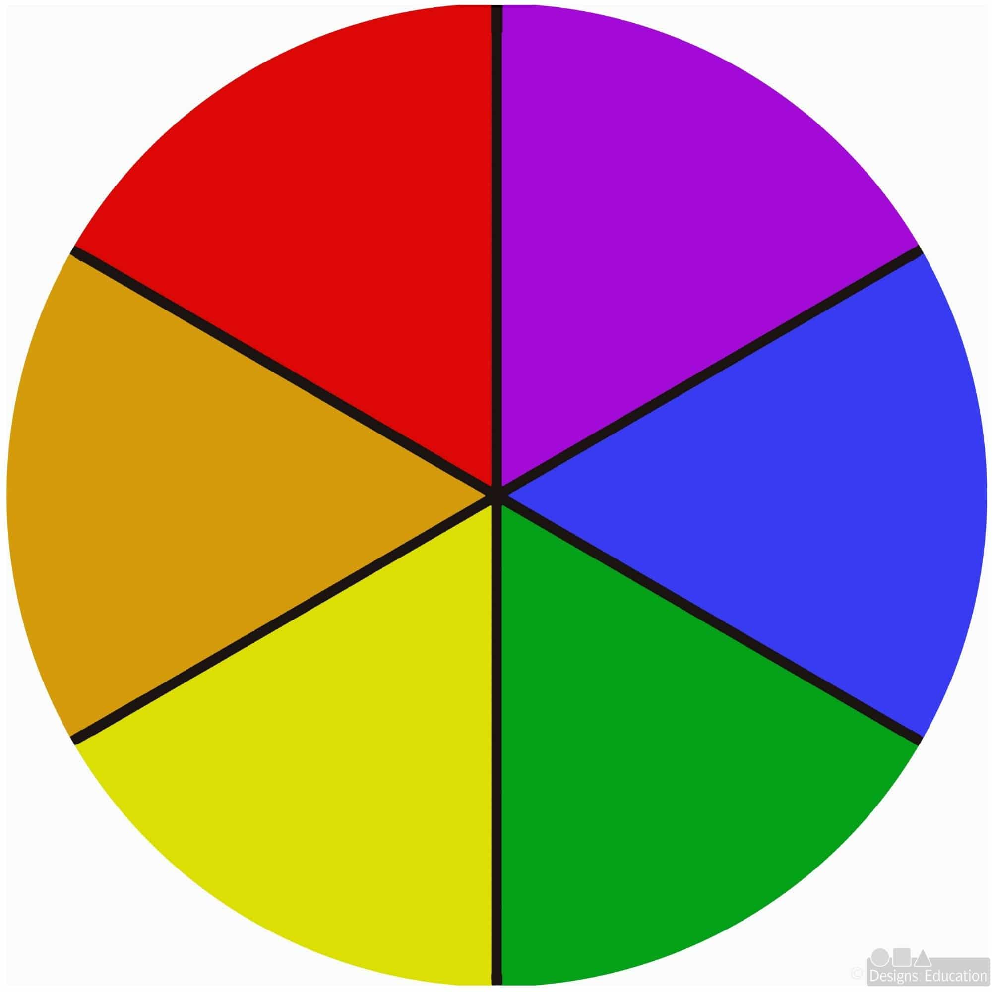
Colour Wheel
This basic colour wheel consists of:
3 primary colours and
3 secondary colours.
The three primary colours are yellow, blue and red. Primary colours cannot be made but are used to make all other colours.
When you mix two primary colours, you get a secondary colour:
Red + Blue = Purple
Blue + Yellow = Green
Yellow + Red = Orange

Slide 3
Task 1: Create your own colour wheel with found objects and photograph it.
Your task is to find objects in your environment that represent each colour on the colour wheel. Next, you are going to arrange them in proper order so that each secondary colour is positioned between the two primary colours that are used to make it. There are some exemplars on the following slide. You can use these as inspiration to get started but aim to be creative and come up with your own ideas.
Once you have made your colour wheel, take a few photographs and send the best one to your teacher. Have fun!

Slide 4
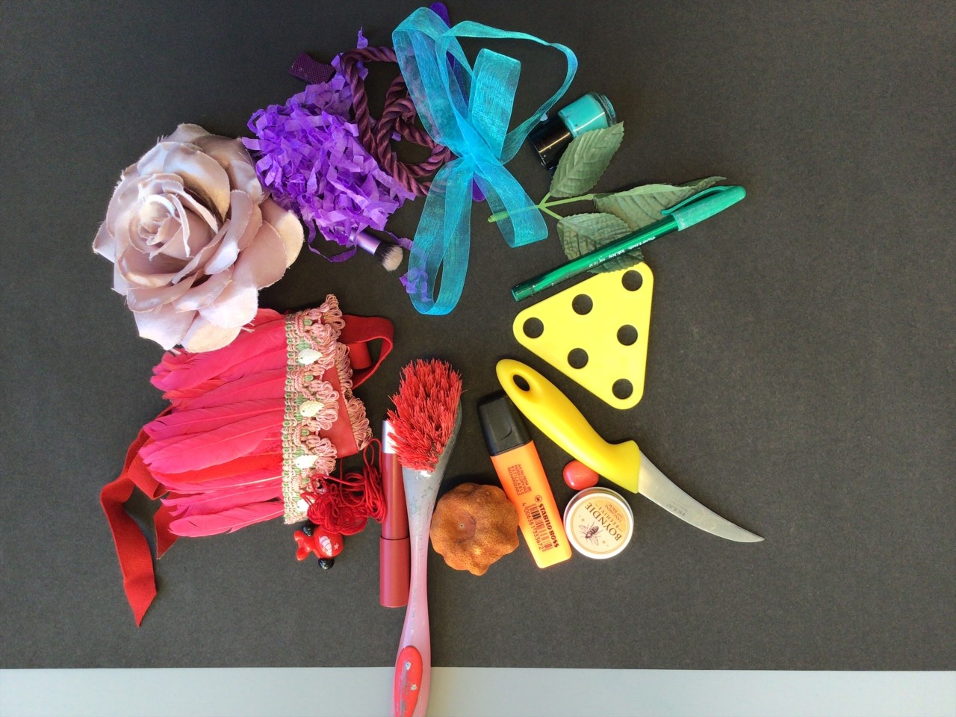
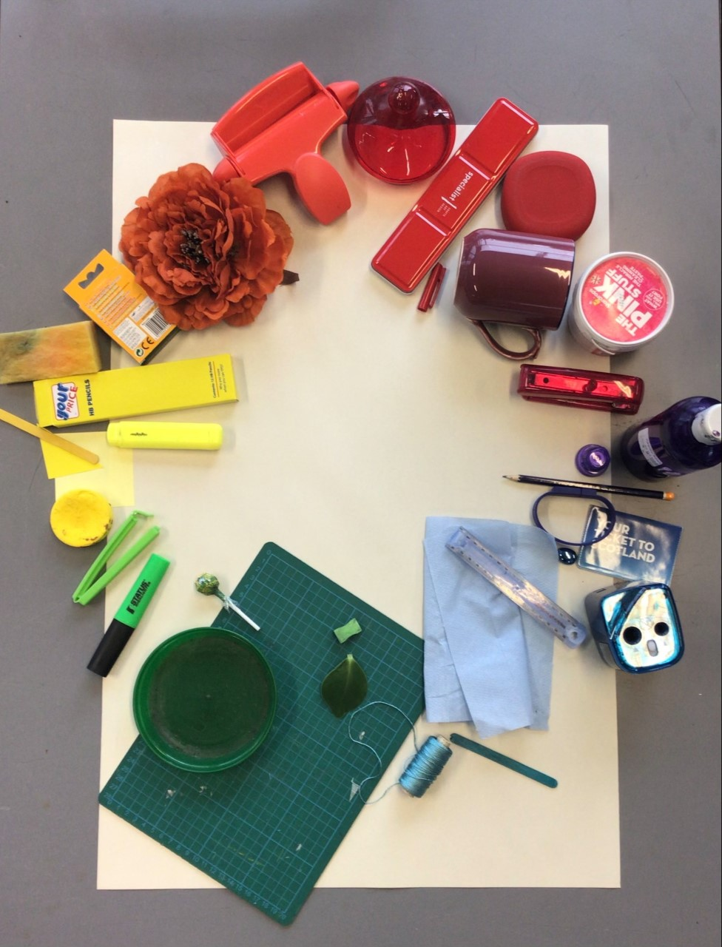
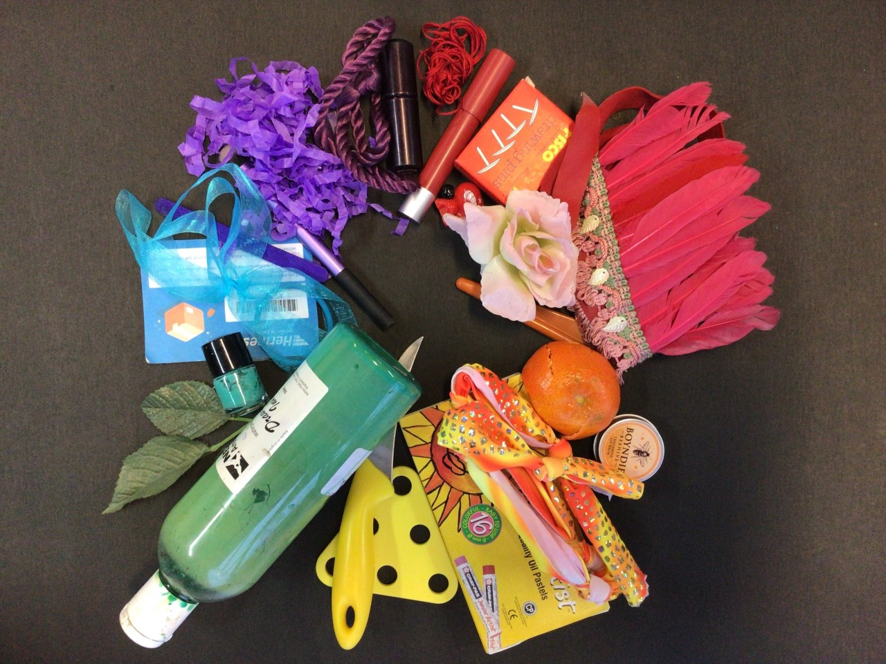
Exemplars:

Slide 5
Now assess yourself. How confident did you feel doing Task 1?
I need help!
I am beginning to understand.
I can do this by myself.
4 I can help someone else.

Slide 6
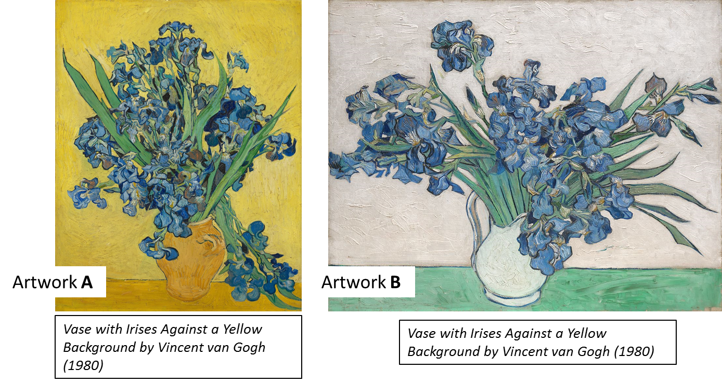
Task 2: Answer the following questions in a Word document or a piece of paper. You may use Google to research the answers.
Q1) What are harmonious colours?
Q2) In which of the following artworks has the artist used harmonious colours?
How do they make you feel?

Slide 7
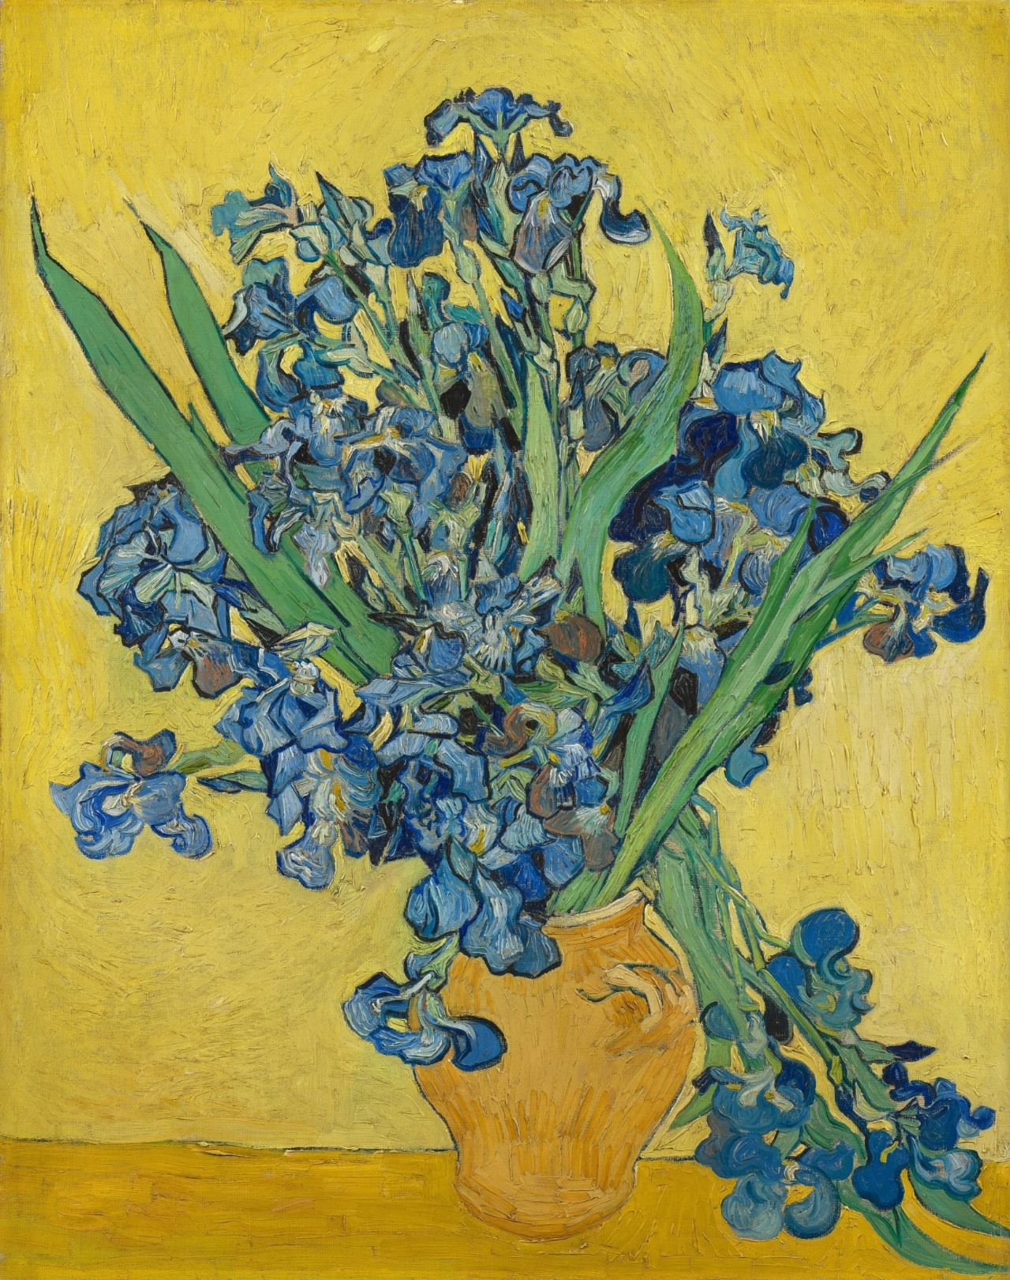
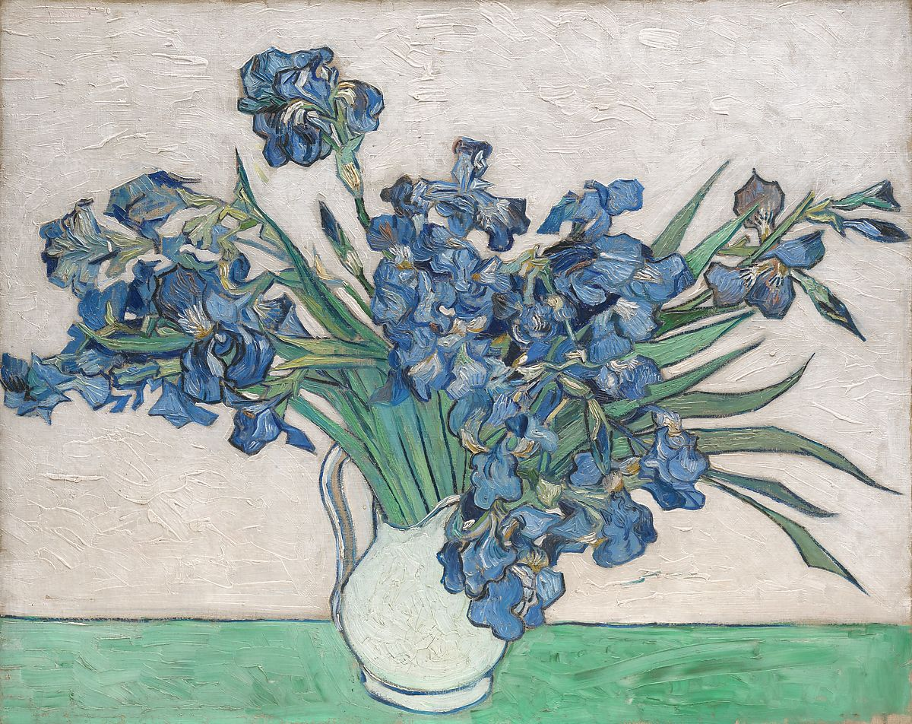
Q3) What are contrasting colours?
Q4) What is another name for contrasting colours?
Q5) In which of the following artworks has the artist used contrasting colours?
How do they make you feel?
Artwork A
Artwork B
Vase with Irises Against a Yellow Background by Vincent van Gogh (1980)

Slide 8
Q6) Colours are often associated with different emotions and moods. Which colour(s) would you use to describe the following?
Joy
Grief
Isolation
Excitement
Anxiety
Rage
Calmness
Q7) Warm colours tend to advance (stand out) whereas cool colours tend to recede (go into the distance). Can you list 3 warm and 3 cool colours?

Slide 9
Now assess yourself. How confident did you feel doing Task 2?
I need help!
I am beginning to understand.
I can do this by myself.
4 I can help someone else.

