Slide 1
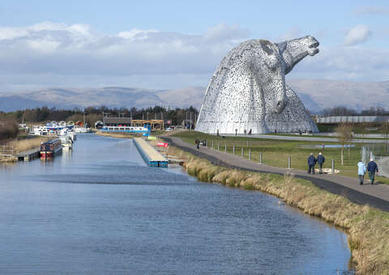
Canal Connections Project
This project will be delivered by teachers in the following departments
Social Subjects
Science
English

Slide 2
History and Heritage
When were canals built?
Why were canals built?
Who built the canal?
Heritage Hero Award
Environment and Wildlife
Habitats
Invasive Species
Sampling
What lives there?
Resource Pack for Primary
Tourism
Comparison to other Canal Systems
Tourism
How to Regenerate?
Presenting our Findings
Multi Media Project
Filming
Photography
Text
Digital Layout
Meta - Skills Development
Integrity – how do we respect and interact with out local environment and community?
Initiative – can we develop resources that primary children could use?
Collaborating – how well do we work work with others?
Communicating – can I make my ideas clear to other people?
Curiosity – how much do I know about my local area and environment? How can I develop this?
Sense making – can I understand the samples that I take?
Creativity – can I use my Ipad to create engaging content?

Slide 3
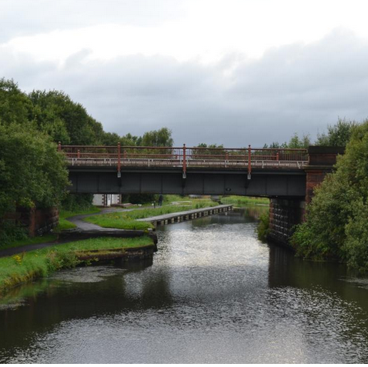
Why you should pick this project…….
If you are interested in Outdoor Learning.
If you are interested in building links with community.
If you are interested in working towards a Heritage Hero award.
If you are interested in our local History.
If you are interested in the environment.
If you are interested in Tourism.
If you want to develop your multi-media skills.
If you want to develop your confidence.
If you want to work with a team.

