Slide 1

Health and Safety
S1/S2 Introduction to H&S

Slide 2
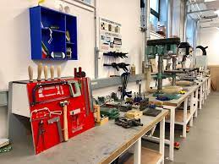

Lesson Starter
Discuss with a partner:-
What do you think would be the hazards in a workshop? You can see some examples of a workshop in the photos.

Slide 3
Learning Outcomes
Learning Intentions
Success Criteria
How to apply safe working practices
I can recognise safety signs, symbols and hazards
UNCRC:- Article 29 -Education must develop every child’s personality, talents and abilities to the full. It must encourage the child’s respect for human rights, as well as respect for their parents, their own and other cultures, and the environment.

Slide 4
Why is health and safety important?
Health and Safety in a workshop is very important.
If a student uses equipment, tools and machinery, they should have received safety training.
This should ensure that they feel confident in the use of machines and can operate them without having an accident or causing an accident to other people!

Slide 5

Health & Safety in Design and Technology
Before you can use equipment and machines or attempt practical work in a workshop you must understand basic safety rules.
These rules will help keep you and others safe in the workshop!

Slide 6
General Safety Rules
1. Always listen carefully to the teacher and follow instructions.
2. Do not run in the workshop, you could ‘bump’ into another pupil and cause an accident.
3. Know where the emergency stop buttons are positioned in the workshop. If you see an accident at the other side of the workshop you can use the emergency stop button to turn off all electrical power to machines.
4. Always wear an apron as it will protect your clothes and hold loose clothing such as ties in place.
5. Wear good strong shoes. training shoes are not suitable.
6. When attempting practical work all stools should be put away.
7. Bags should not be brought into a workshop as people can trip over them.
8. When learning how to use a machine, listen very carefully to all the instructions given by the teacher. Ask questions, especially if you do not fully understand.
9. Do not use a machine if you have not been shown how to operate it safely by the teacher.
10. Always be patient, never rush in the workshop.
11. Always use a guard when working on a machine.
12. Keep hands away from moving/rotating machinery.
13. Use hand tools carefully, keeping both hands behind the cutting edge.
14. Report any damage to machines/equipment as this could cause an accident.

Slide 7
Health and Safety Signs
When in the workshop , you will see lots of different safety signs.
Let's have a look at some of these – see if you can guess what each mean!

Slide 8


Slide 9


Slide 10


Slide 11


Slide 12


Slide 13
How many of them did you recognise?
I am sure most of you have seen signs like those before!
Did you know the signs are colour coded depending on what they mean?
We have signs in
Red Blue Yellow Green

Slide 14
What do the colours mean?
Red signs are prohibition signs – this means do not do
Blue signs are mandatory signs – this means you must do
Green signs are safe condition signs – indicating safety
Yellow signs are warning signs – giving a warning of a hazard or danger!

Slide 15

Task 1 – Health and Safety Hazards- 15 mins)
Open up Teams on your iPad. Open up our team and go to 'class notebook'
Click on your name and then on 'class notes'
Complete the 'Health and Safety' exercise in your class notes.
(if you finish, go in to 'quizzes' and complete the exercise)

Slide 16
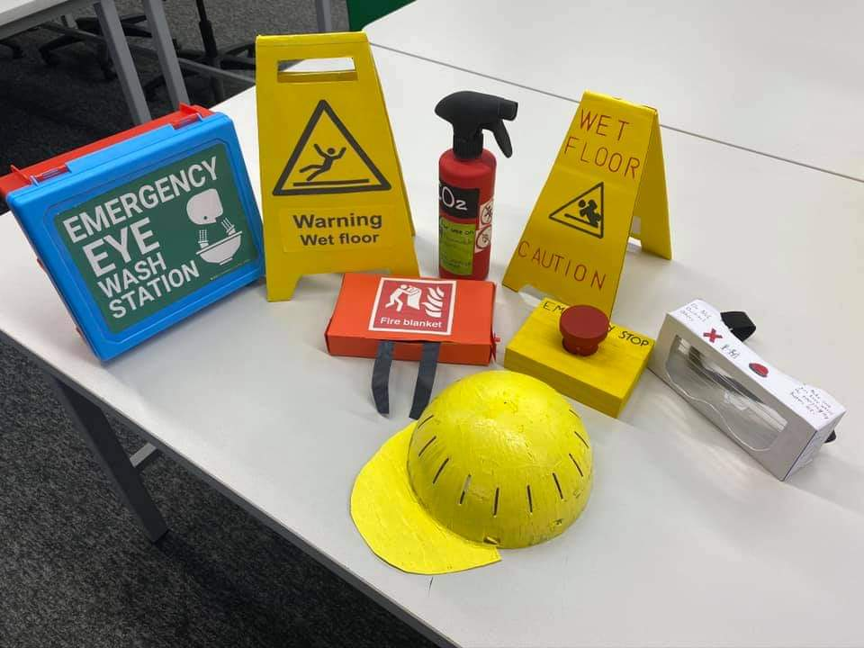
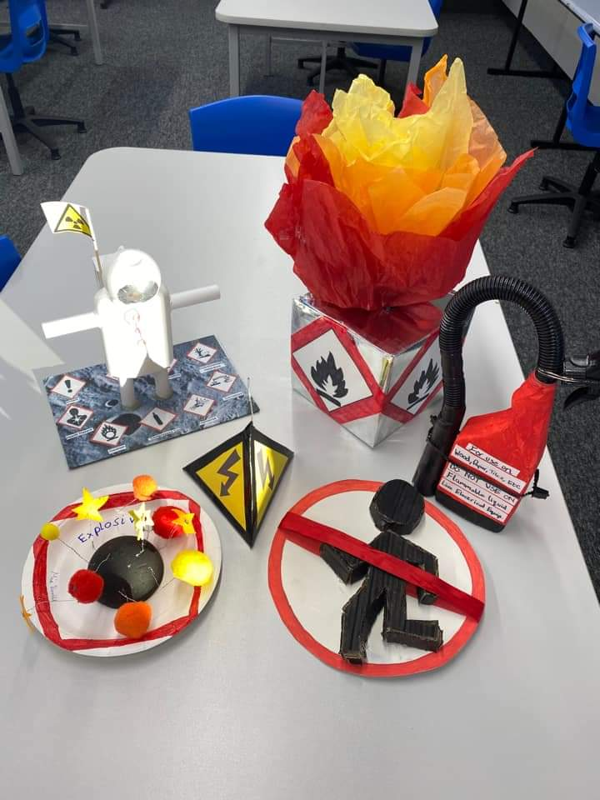
Homework!
Your homework is to make a health and safety model –
See some examples:-
This is due 1 week today.

