Slide 1

Satchel One
(previously Show My Homework)
Pupil Guide

Slide 2
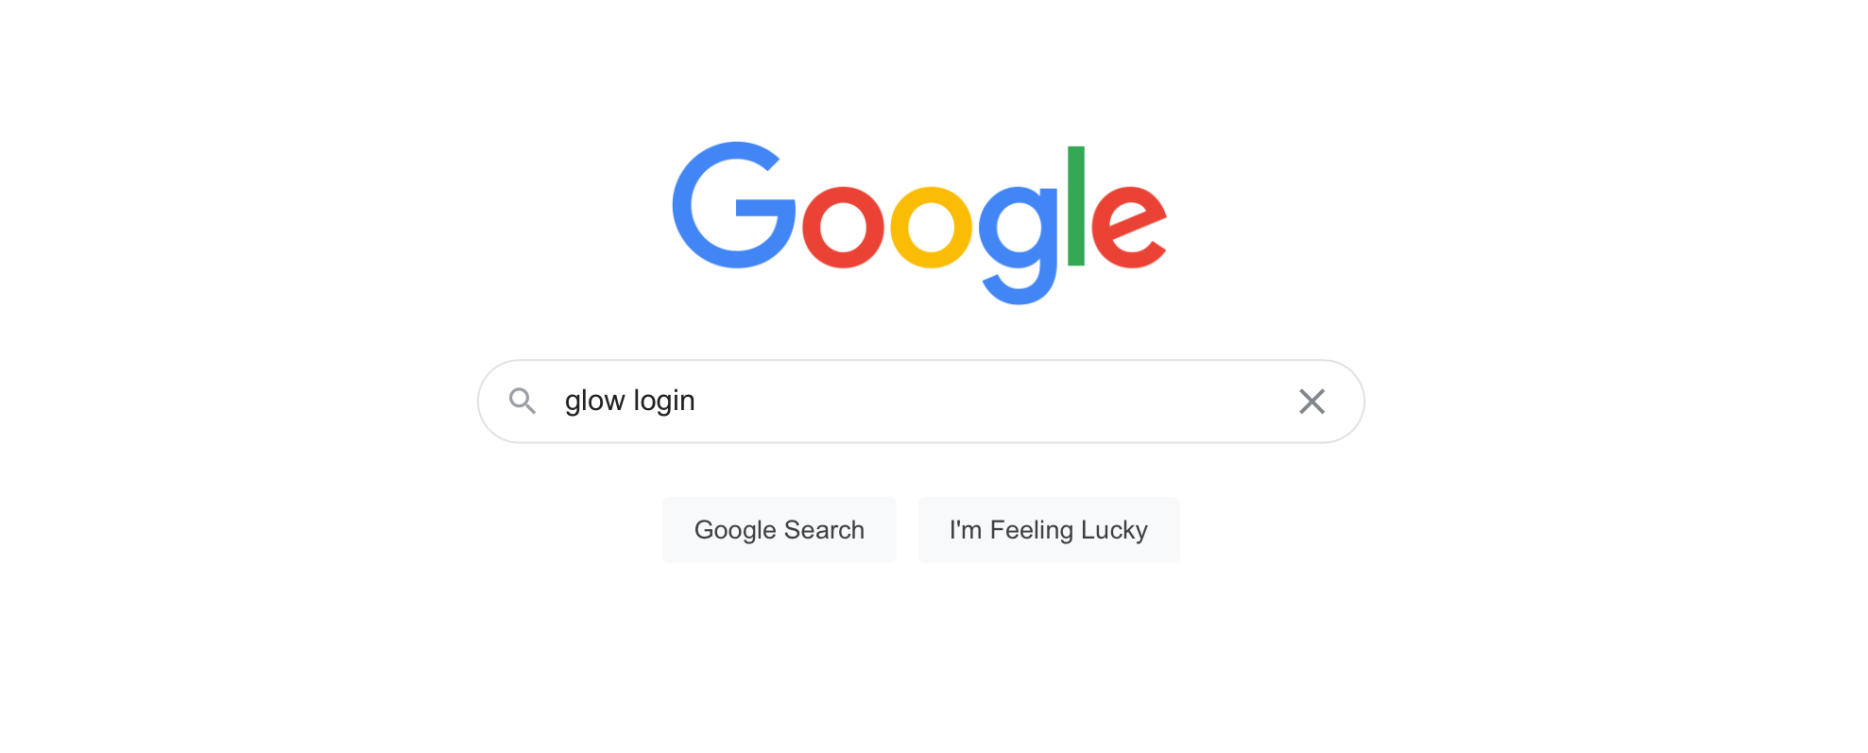
Step 1
Go to google and search
‘glow login’

Slide 3
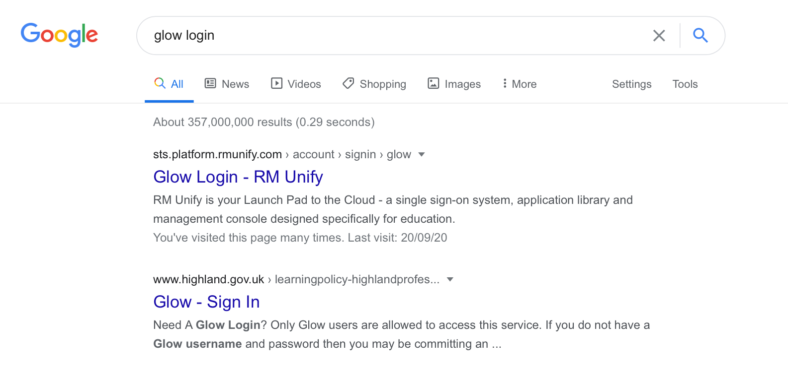
Step 2
Select ‘glow login – RM unify’

Slide 4
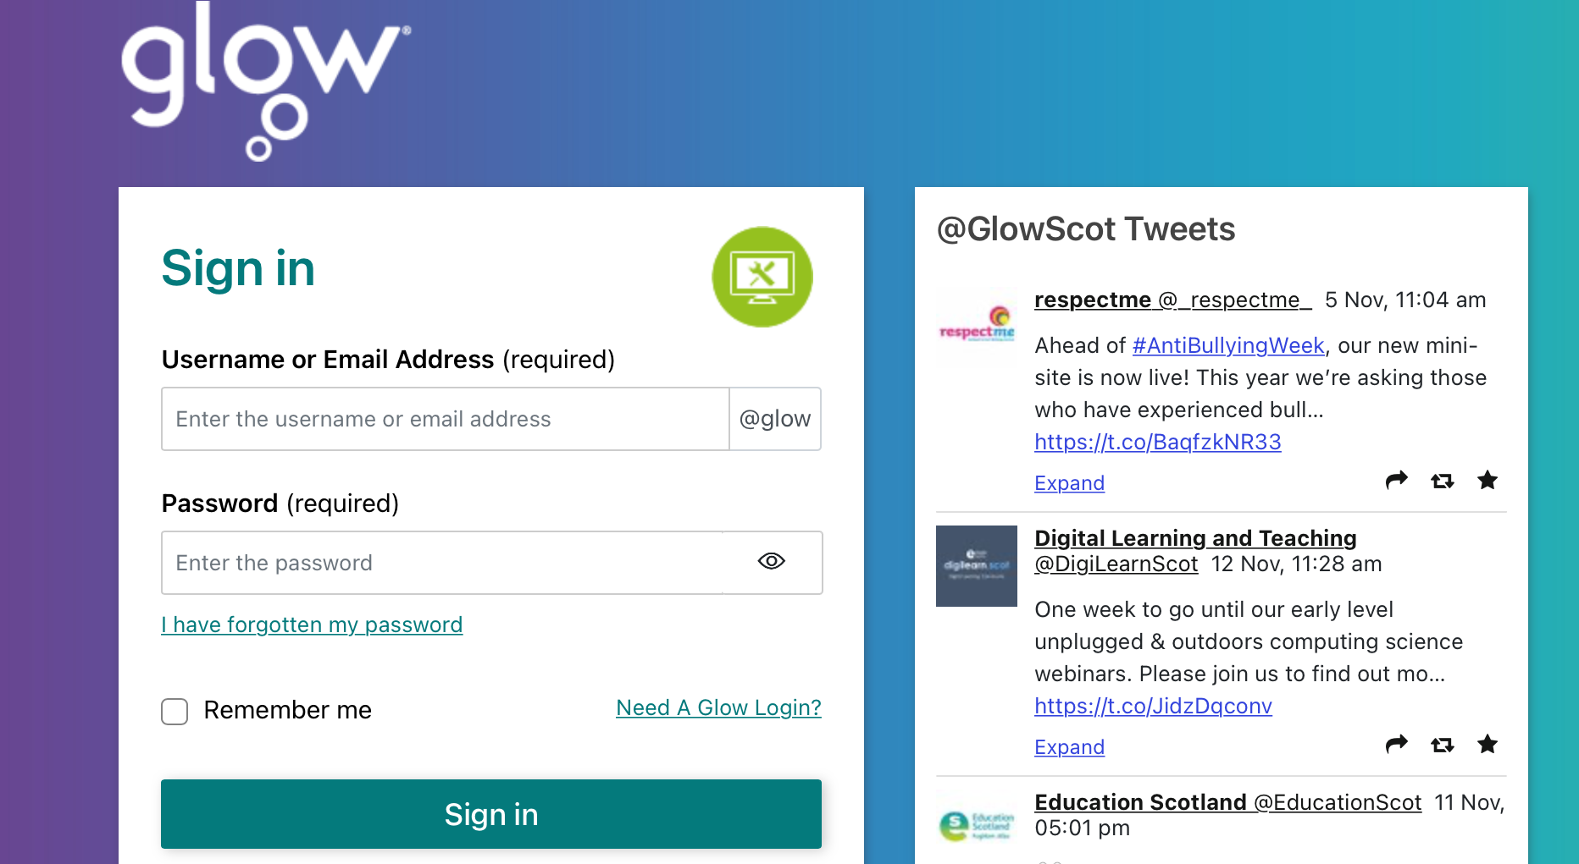
Step 3
Enter your Glow username and password.
If you don’t already have this or have forgotten your password, please ask any teacher to help.

Slide 5
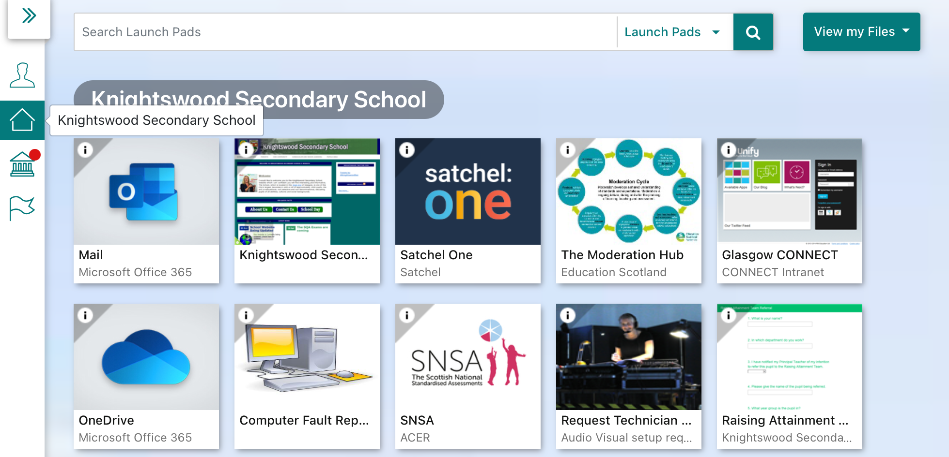
Step 4
Select the ‘Home’ icon the click on the ‘Satchel One’ tile.
You should now be able to access Satchel One.

