Slide 1
Getting to know your iPad

Slide 2
Common Questions/FAQ’s
Internet issues? Turn your iPad off then on again. Go to Safari. Wait for the ‘Proxy’ pop up and enter your computer username and password.
If you forget your password ask a member of staff to reset it. You must log onto a computer and change it from the default ‘welcome’ to something else.
‘Verify Apple Id’ pop up? Your Apple ID passcode should be the same as your code to unlock your iPad. Email Mrs Seagrave if you need this reset.
Self Service issues – if this is not connecting to the internet, delete the app and it will automatically download again within 24 hours.
Battery not charging all the way? Let your iPad drain completely of battery, leave it over night not on charge, charge it in the morning. Best to do this at a weekend!
iOS update? Do this in the evening, plugged into your charger and on WiFi.
Locked out of your iPad? Email Mrs Seagrave if you need this reset.

Slide 3
Adjusting Your Screen
You may want to increase your font size or add some accessibility features such as a colour overlay.
You can do this by…

Slide 4
Go to settings and choose Accessibility

Slide 5
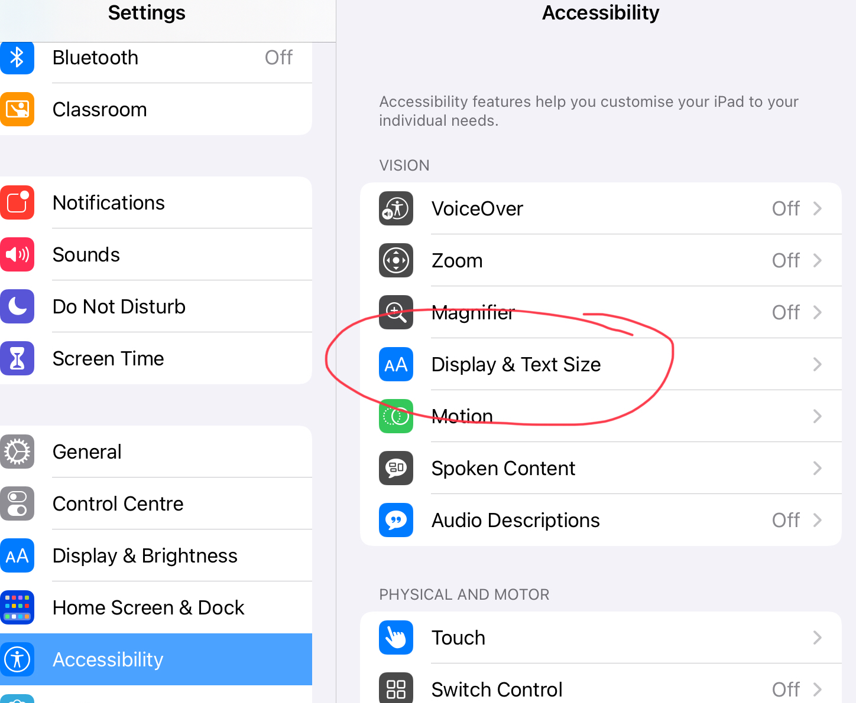
Here you will find lots of options including Display and Text size

Slide 6
To add a filter select Colour Filters

Slide 7
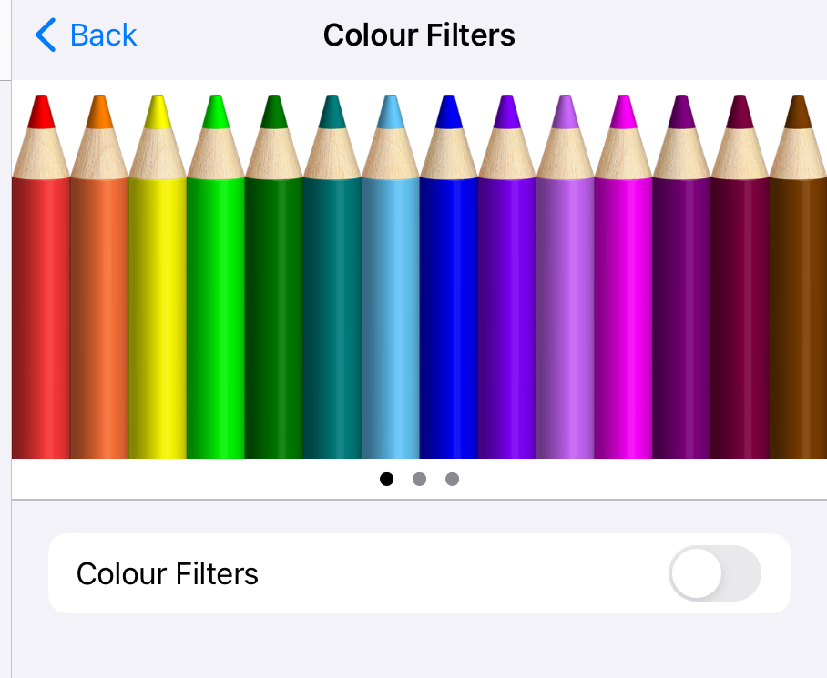
Here you have plenty of options to suit your needs!

Slide 8
Setting up your Emails
It is a good idea to set up your Outlook app for emails to save you having to log onto Glow via safari all of the time!
Follow these steps to do so.

Slide 10
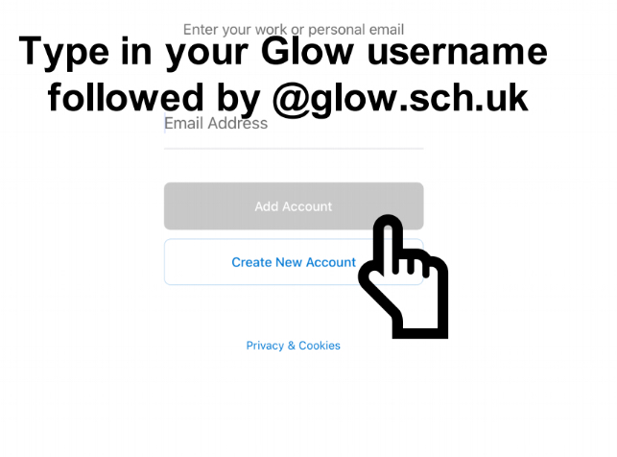

Slide 11
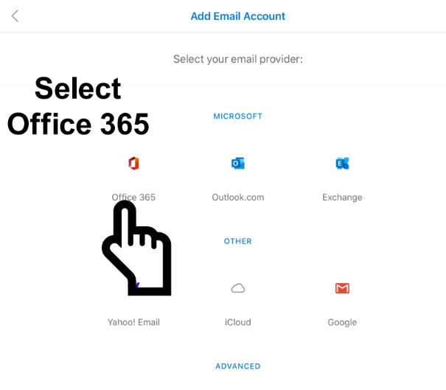

Slide 12
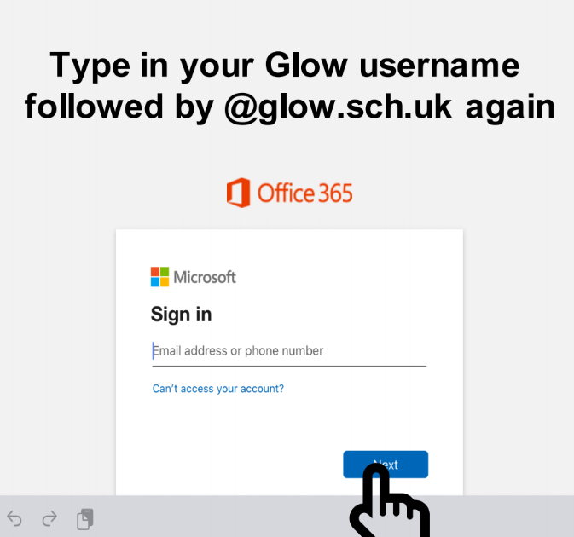

Slide 13
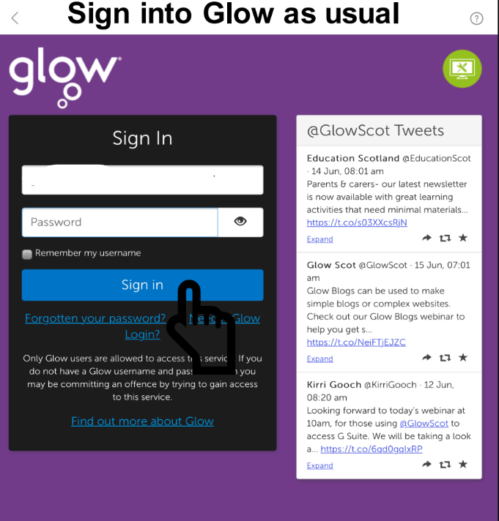

Slide 14
Glow Issues
If your have forgotten your glow password, any staff member can reset this
For staff: this can be found by logging into glow via safari/internet browser, selecting Management Console in the top tool bar then searching for the pupil!

Slide 15
Saving Your Work
There are many features for saving your work.
We will now go through some options.
To have OneDrive as an option in your other apps, you should have the app downloaded and log into it with your glow email.

Slide 16
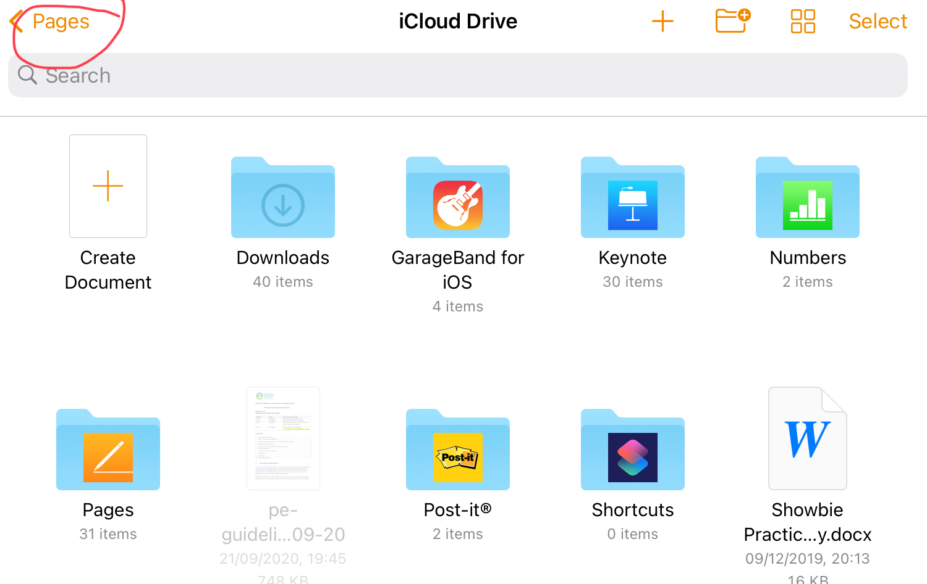
Open an app like Pages

Slide 17
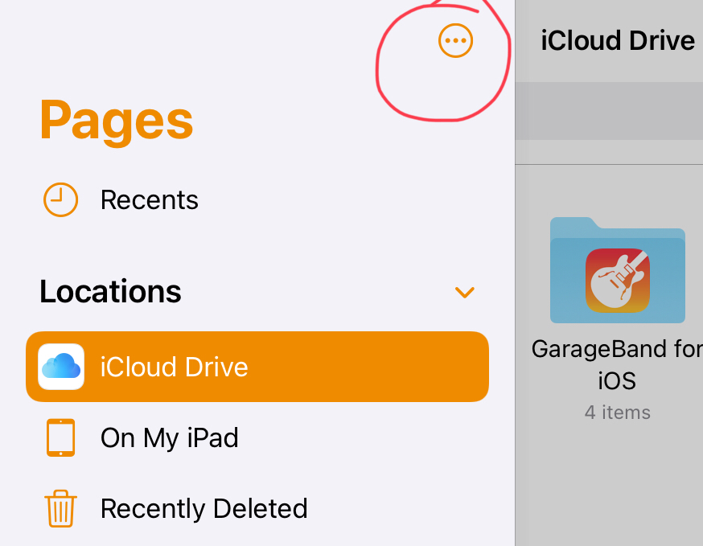
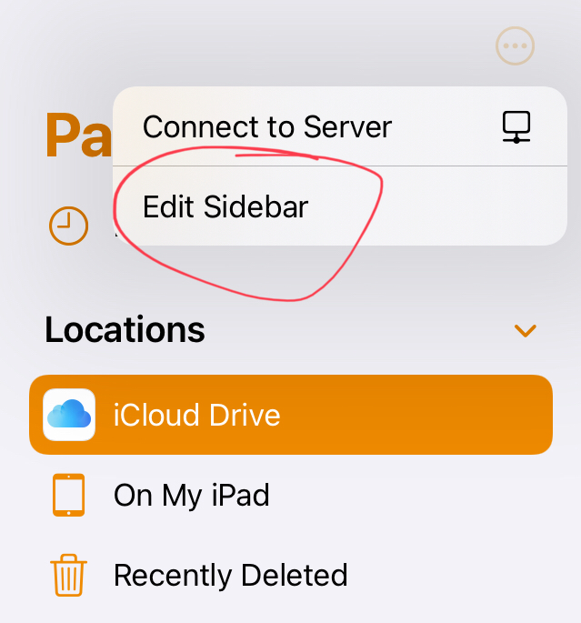
Select the Three Dots, then edit sidebar.

Slide 18
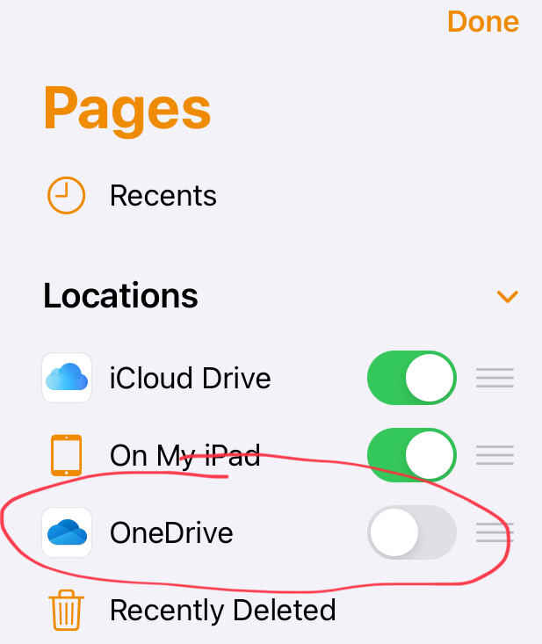
Swipe the toggle right to turn OneDrive on

