Slide 1
KSS ights especting chool
R
R
S
By Martha Davidson, S5

Slide 2
What is ?
R
R
S
Rights Respecting School
(RRS) is
where the school works with the pupils to
promote and realise child rights.

Slide 3
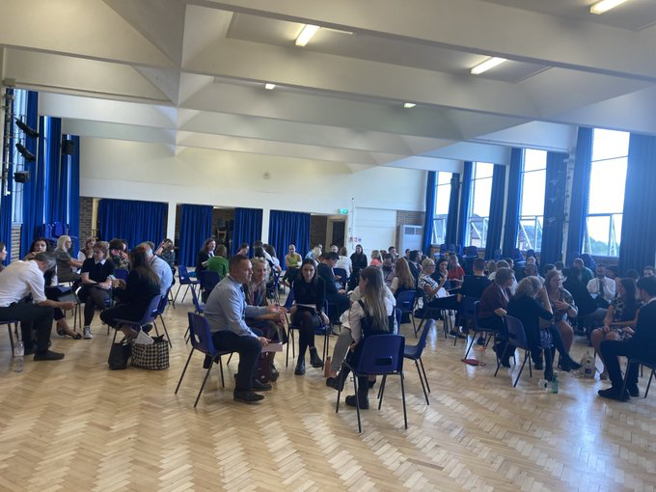
What have RRS done to help KSS?
is a club
which helps aid the development of
pupils rights at KSS. We recently
started rewarding pupils for
demonstrating the school values
with treats, and teachers have been
trying to implement the language of
the charter in their classes. However
if pupils misbehave, they can receive
a reflection card to think about their actions.
Rights Respecting School

Slide 4
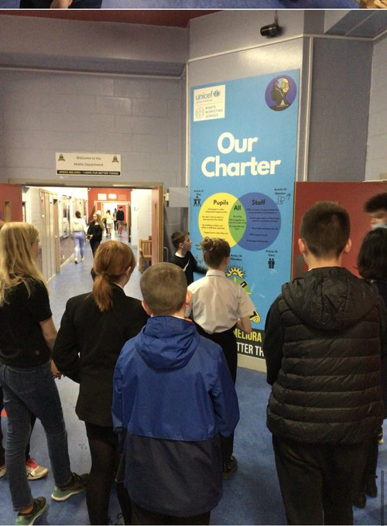
They also went on a trip to Hyndland
Secondary to see how the promote
children’s rights and they got some
inspiration. This was effective and now we
have banners and posters all around our
school. They were also inspired to help
pupils the worked together to create the
new charter and values for KSS so everyone
feels involved.

Slide 5
Leadership
Pupil
In the end of last year, KSS has formed a captaincy team to help involve pupils in events and changes in the school. We’ve given S5 and S6 pupils the chance to take on leadership roles within KSS and allowed them to become a part of the wider school community. Those who were interested were able to chose from become a Captain, Vice Captain or a Prefect.
The Captains, Vice Captains and Prefects have been involved in supporting many after school events such as parents' evenings, information evenings and speaking at assemblies. The Christmas fair, monitoring during lunchtimes and at the Halloween Ghost Tours, and organising events for the school.

Slide 6
Our Commitment to Equality
It’s very important to us at KSS that everyone feels represented and equal. To ensure this, we asked pupils which historical days they felt needed to be highlighted in school. Thanks to their feed back the following Days are now taught and valued across our school and curriculum:
International Women’s Day
The Elimination of Violence Against Women
Black History Month
Holocaust Memorial Day
The The school also runs an LGBT+ Group that meets every lunchtime and an Anti-Racist Club that meets on Wednesdays.

Slide 7
How to Get Involved
If you are
interested in joining
Rights Respecting School
then just ask Mrs Adams,
Mr Hanrahan, Ms McMillan
or Mr Oakes and
they’ll be happy
to let you join.

Slide 8
Our Vision
Learning Together
Working Together
Succeeding Together

Slide 9
Our Values
Respect
Honesty
Friendship
Empowerment
Happiness

Slide 10
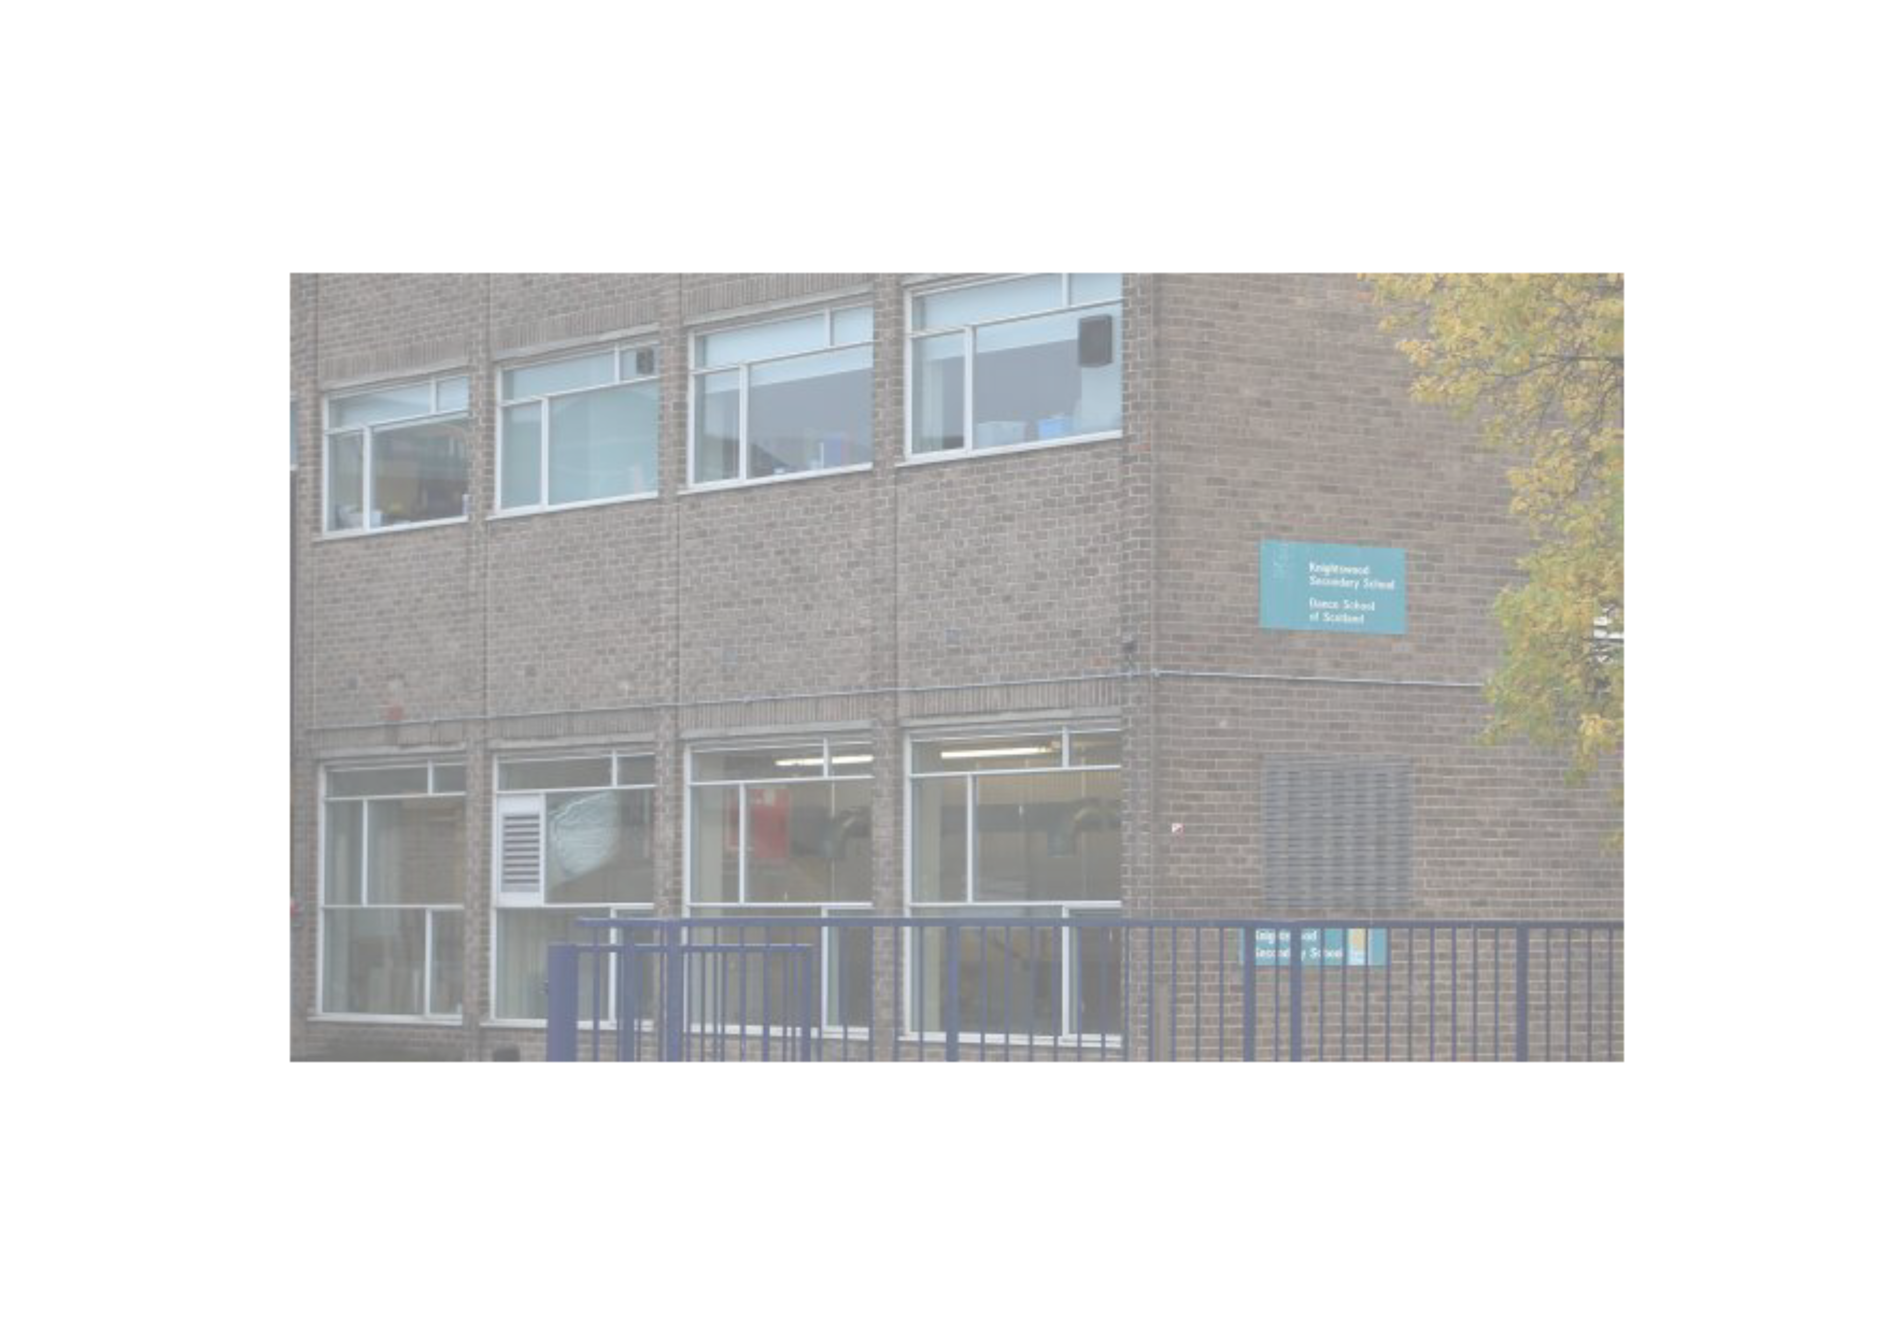
Our Charter
Be Kind
Giving Our Best
Be Honest
Respect Others
Be Responsible
Include Everyone

Slide 11
Important KSS Information
Address: 60 Knightswood Rd, Glasgow G13 2XD
Hours: Mon-Wed 08:45-15:30 Thu-Fri 08:45-14:40
Phone Number: 0141 582 0160
Twitter: @KnightswoodSec

