Slide 1
S1 French
You can log into www.linguascope.com for practice for each topic.
Username: kssfrench
password: ml2020

Slide 2
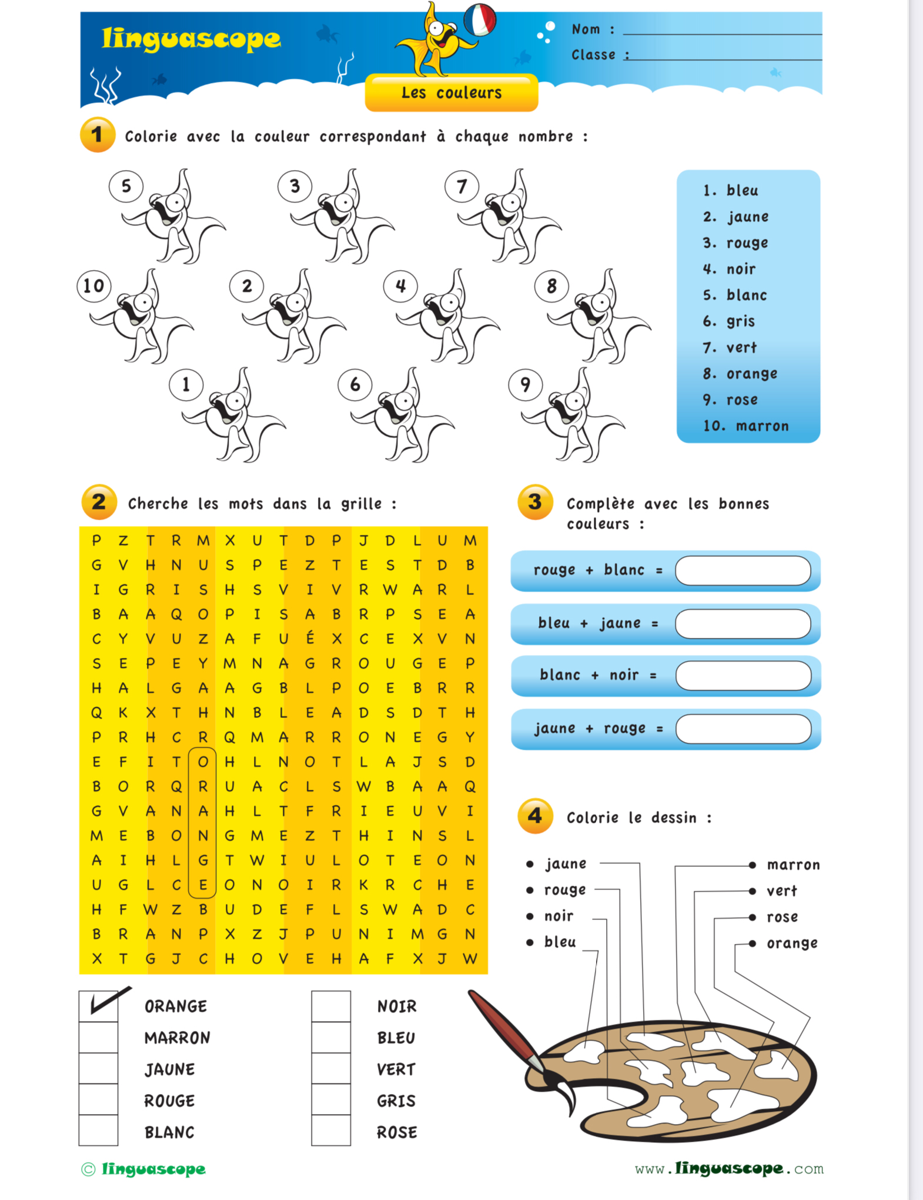
Colours
Match the following:
1. bleu a. green
2. rouge b. white
3. vert c. brown
4. blanc d. grey
5. marron e. blue
6. gris f. red

Slide 4
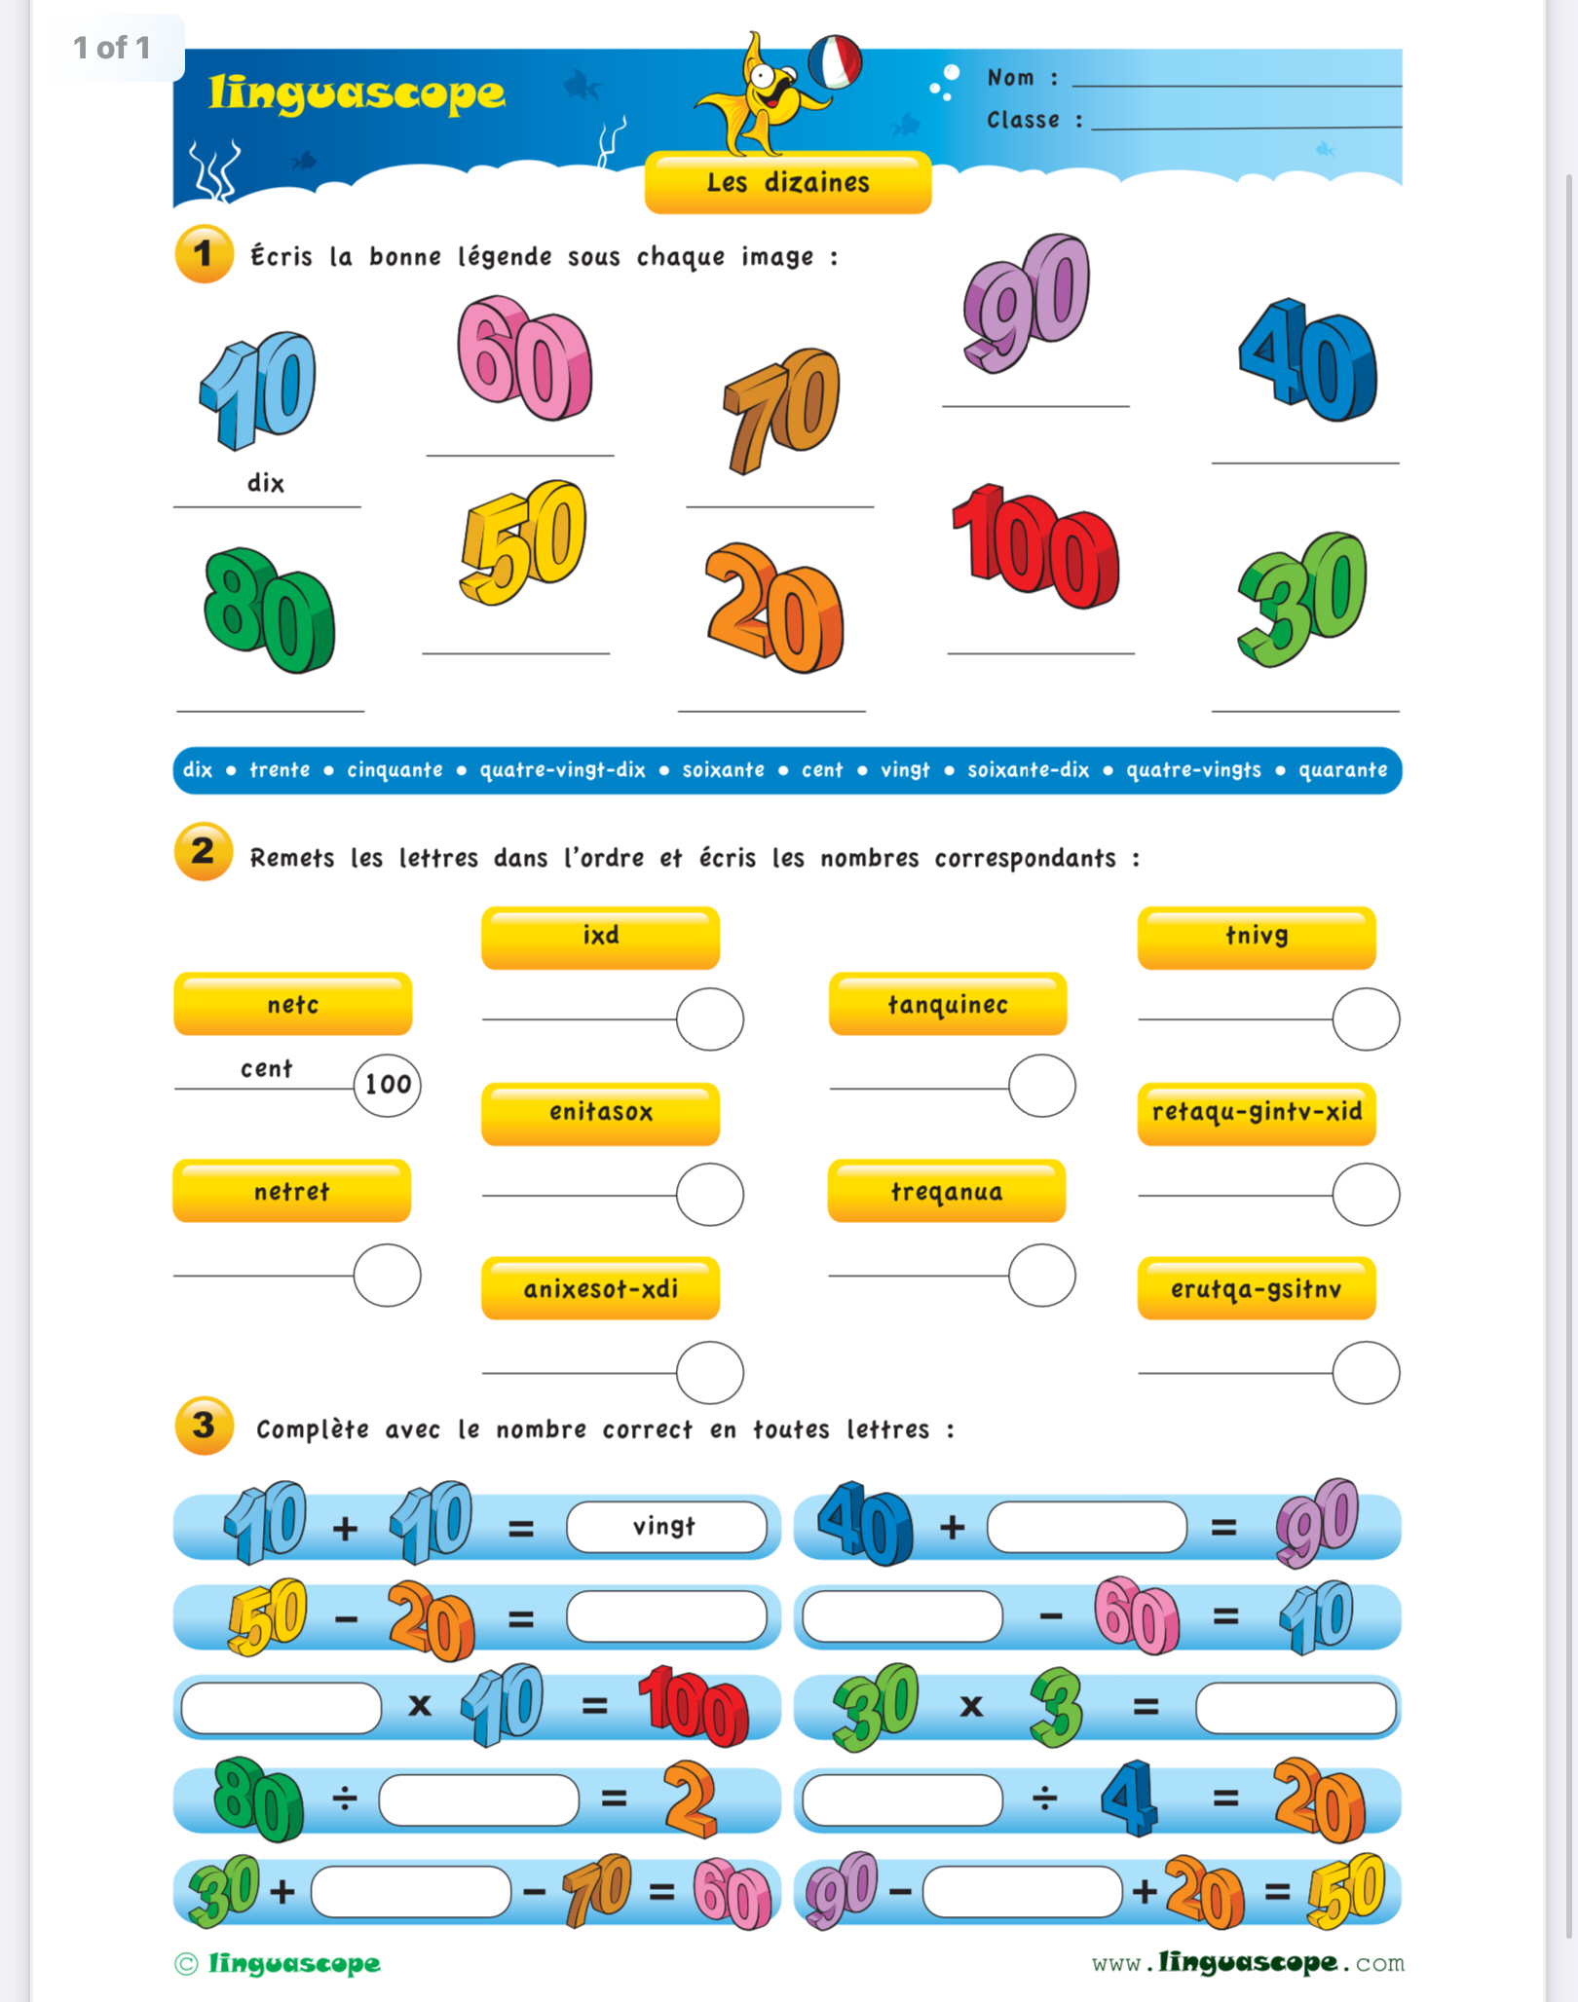
Practise your French numbers

Slide 5
Les animaux

Slide 8
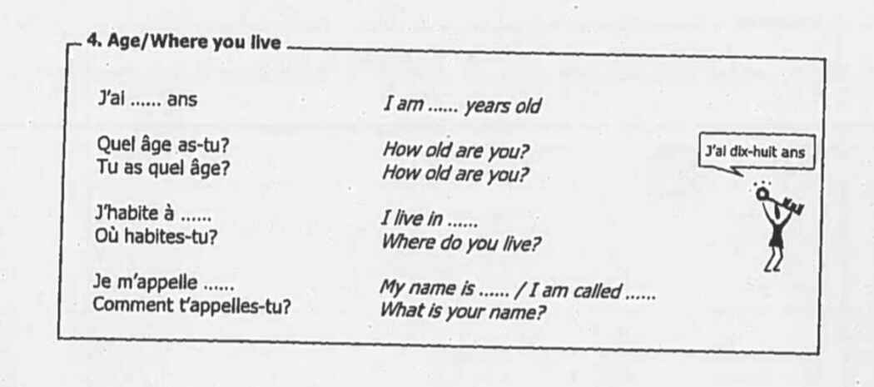
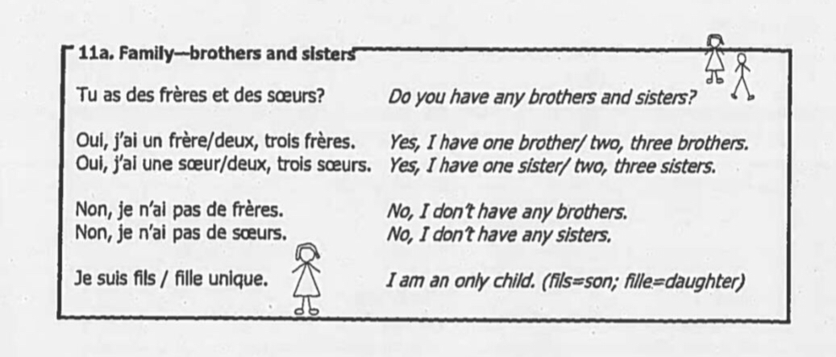
Write about your family using the vocab to help
Include:
Name
Age
Where you live
Family

