Slide 1
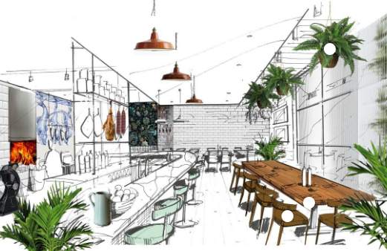
S2 STEM Project
ECO CAFE

Slide 2
What is STEM?
STEM subjects teach you important transferable skills, such as critical thinking, problem-solving and the ability to work as a team. Whilst these are all vital skills if you wish to go on to study science or technology, they can also be applied to almost any profession, making them an incredibly valuable skill set.

Slide 3
Learning Outcomes
In this project you will be working across 5 different subject areas to produce your portfolio.
Design & Technology
Computing
Food Technology
Business
Physics
Floorplan
Perspective Visuals
Logo Design
Shop Front
Creating a website design for your café
Creating a Menu
Planning an opening event
Creating a business plan
Costing and budget
Promotional Campaign
Exploring sustainable energy sources
Constructing domestic wind turbine

Slide 4
Available Prizes
At the end of the 2 week session you will have the opportunity to pitch your design to a panel of subject experts at Scholar’s Lair. The panel will decide what group will win each category. Prizes will be awarded at the showcase event in June.
Best in Computing
Best in Design and Technology
Best in Physics
Best in Business
Best in HFT

Slide 5
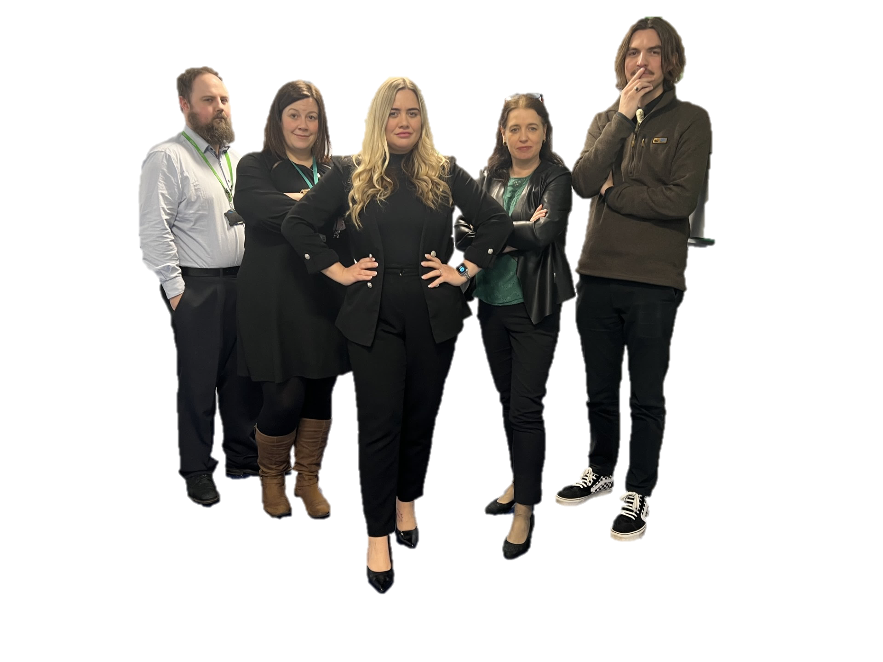

Slide 6
S3 Subject Choices
Remember to choose an activity that reflects your subject choices for S3 as you will develop a range of important skills to support your learning. Relevant subject choices are shown below.
Design and Manufacture
Graphic Communication
Hospitality
Business
Admin
Computing
Physics

