Slide 1
resources | projects | professional learning
The Global Goals For Sustainable Development
starter activities
scotdec.org.uk
@scotdeclearning
/scotdeclearning

Slide 2
Introduction
What are the SDGs?
The Sustainable Development Goals
are our global targets for 2030…
Watch this YouTube video
2
2
Notes:
Introduction
We live in an increasingly interconnected and interdependent world - which faces many social, environmental and economic challenges.
In 2015, the nations of the world agreed on 17 Sustainable Development Goals to tackle these challenges - and Scotland became one of the first countries to sign up.
The Goals are now at the heart of the Scottish Government’s vision, but they can only be achieved if we all play our part.
Our educators, young people, and the communities we live in have a key role in making this a reality.

Slide 3
Getting started…
Your community
Your school
The people you live with
You
Scotland
The world
With the SDGs
Think about what matters to…
3
Notes:
Sometimes the challenges facing our world can seem overwhelming – but if we all ‘act local’ whilst ‘thinking global’, we CAN make a difference.
After all, as Margaret Mead once said, ‘Never doubt that a small group of thoughtful, committed citizens can change the world. Indeed, it is the only thing that ever has.’
If a small group of individuals can change the world, imagine what a large group, or whole school, or wider community, or town or nation could do!
Get started
What matters to you?
What matters to your family or the people you live with?
What matters to your community? What would make it a better place to live in for everyone and everything that lives in it?
And what about the bigger picture – what would make Scotland, or the planet, a better place for everyone and everything?
Real change happens when it is identified, implemented and owned by the people and communities it affects. By using this pack, you’ll not only be able to explore what each of the 17 Sustainable Development Goals is all about, but identify and come up with ideas and actions that you can turn into reality.
Dan Millman once wrote that ‘the secret to change is focusing all of your energy: not on fighting the old, but building the new’. Be part of the movement towards a better world – for everyone and everything!

Slide 4
Activity 1
Numbers in action
Watch this video
Write down some of the numbers, facts and targets for 2030.
Discuss as a class. What’s your opinion of the Goals and what they’re trying to achieve?
4

Slide 5
Activity 2
Celebrate the goals!
Watch this video
Which celebrities do you recognise?
Do you think matching celebrities to goals matters?
5

Slide 6
Activity 3a
The Triangle
People? Planet? Places? Ways of making things better?
Which matters most to you here in Scotland?
6

Slide 7
Time to explore the goals…
Time to think big!
7

Slide 8
Goal 1: No Poverty
Understanding the SDGs
This goals aims to:
End poverty in all its forms - everywhere
8
8

Slide 9
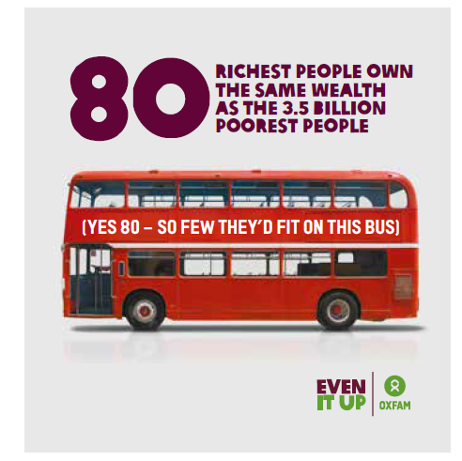
Get started
Find out:
How many people are there in the world?
What do we mean by ‘poverty’?
How many people in the world live in poverty?
Discussion:
Discuss the statistic in this picture
9

Slide 10
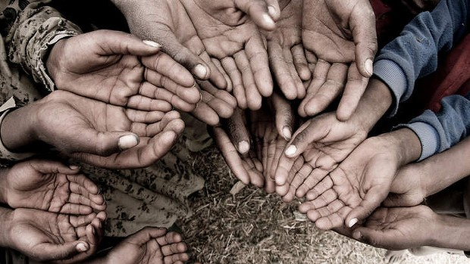
Get started
Chabna’s Story
Discuss
How has Chabna’s life changed?
What caused this change to happen?
Is it still our responsibility to help the poorest if they live in countries where there is now significant wealth? What about those living in poverty in Scotland?
What else could we do to help those in poverty?
Watch this clip
10

Slide 11
Take it further
Use the Comparing Young Lives resource to investigate poverty and inequality around the world with learners.
The Child Poverty Action Group, UNICEF and Save the Children work in Scotland to improve the lives of children and young people living in poverty. Find out more about the work of these organisations. This might including finding out about local foodbanks and how they can be supported.
11

Slide 12
Want more?
Check out these additional resources for this goal:
worldslargestlesson.globalgoals.org/global-goals/no-poverty/
www.teachglobalambassadors.org/curriculum-areas
worldpoverty.io/
12

Slide 13
Goal 2: No Hunger
Understanding the SDGs
This goals aims to:
End hunger, achieve food security and improved nutrition and promote sustainable agriculture
13
13

Slide 14
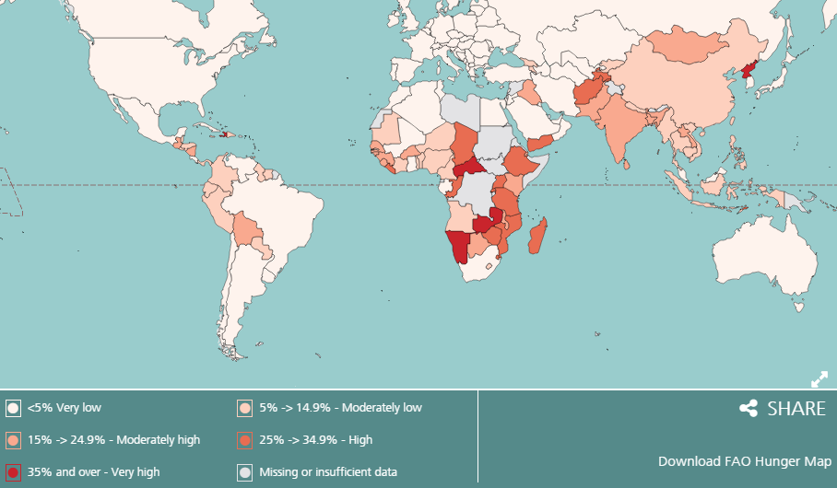
Get started
14
Notes:
Discuss and explore patterns of world hunger.
Are there any surprises?
Does the map allow for enough detail – what about ‘hidden hunger’ in countries such as the UK?

Slide 15
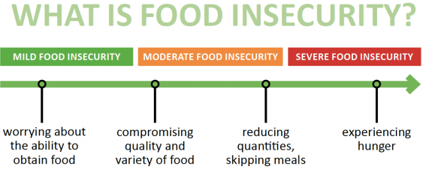
Get started
Hunger in the UK:
15
Notes:
Discuss the UNICEF figures. Do they hold any surprises?
Use the next slide to discuss the causes of food insecurity in more detail.

Slide 16
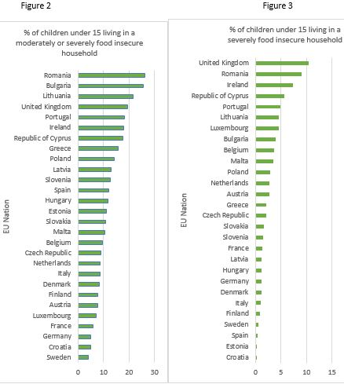
Get started
Hunger in the EU
Source: UNICEF 2017
16
Notes:
Discuss the UNICEF figures. Do they hold any surprises?
Use the next slide to discuss the causes of food insecurity in more detail.

Slide 17
Get started
There are too many people to feed. | People can’t grow enough food because of wars.
Food grown on the best farmland in poor countries is sold to richer countries. | Climate change means regular floods or drought in poorer countries – and increasingly in richer countries.
People in poorer countries are not paid enough for what they grow. | People in richer countries want to pay less for the things they buy, so wages in poorer countries stay low.
The international trading system is unfair to poorer countries. | People are too poor to buy enough food – increasingly in richer countries as well as poorer ones.
About one-third of the food we produce just goes to waste. | The way we produce food is causing damage to the environment and making climate change worse.
17

Slide 18
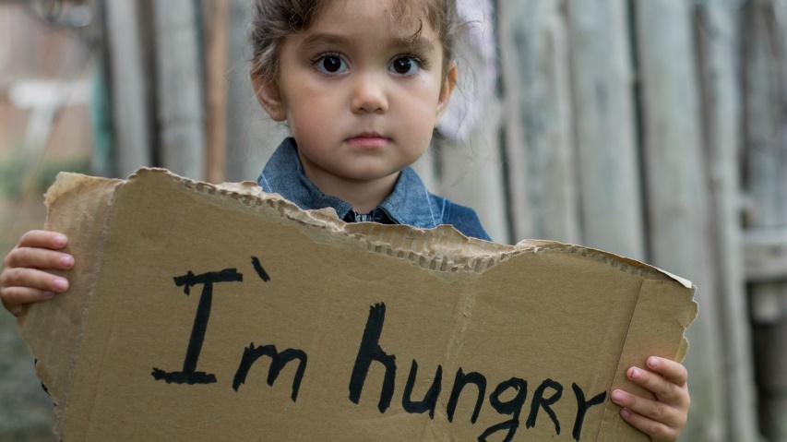
Get started
Why are people hungry?
What needs to change?
What local actions can have a global impact?
What can we do as consumers?
18

Slide 19
Take it further
Find out more about where your food comes from and who produced it. Food Tales from the World’s Largest Lesson has ideas for investigating food and waste. http://worldslargestlesson.globalgoals.org/
Food for Thought from Oxfam Education, has resources for learning, thinking and taking action for a fairer food system. For younger pupils there is Our food, Our world. www.oxfam.org.uk/education
Take a whole-setting approach to sustainable food with Keep Scotland Beautiful’s ‘Food & the Environment resources.
Look at food & food production issues from a Scottish perspective with Education Scotland’s ‘Food for Thought’ resources.
Experience Scottish food production at first hand with help from the Royal Highland Education Trust.
19

Slide 20
Want more?
Check out these additional resources for this goal:
worldslargestlesson.globalgoals.org/global-goals/no-hunger/
teachglobalambassadors.org/curriculum-areas
worldpoverty.io/
fao.org/save-food/resources/keyfindings/en
stv.tv/news/scotland/1413196-scottish-food-bank-use-more-than-doubles-in-five-years/
gov.scot/Resource/0045/00453219.pdf
20

Slide 21
Goal 3: Good Health
Understanding the SDGs
This goals aims to:
Ensure healthy lives and promote well-being for all at all ages
21
21

Slide 22
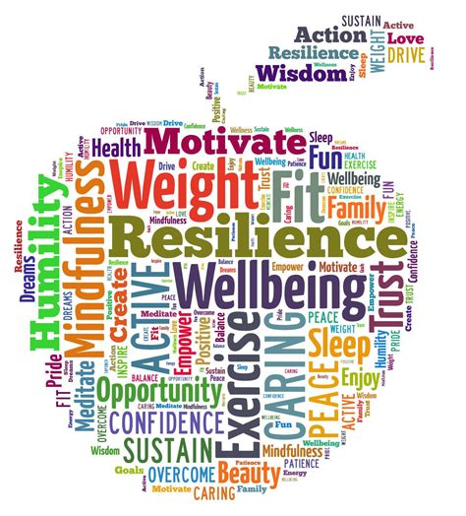
Get started
What does it mean to be healthy in Scotland?
Image: Hamlyn Herald | Kindergarten Happenings
hhamlyn.wordpress.com
22
Notes:
Discuss and explore patterns of world hunger.
Are there any surprises?
Does the map allow for enough detail – what about ‘hidden hunger’ in countries such as the UK?

Slide 23
Get started
By my Government nationally and internationally
By my family and local community
By me
Protecting our right to health
23
Notes:
Discuss the UNICEF figures. Do they hold any surprises?
Use the next slide to discuss the causes of food insecurity in more detail.

Slide 24
Take it further
Use the Going up in Smoke resource to investigate the impact of the tobacco industry on health & wellbeing, the environment, and inequality with learners.
Use the Stop the Spread STEM challenge from Practical Action. Pupils design, build and test a model of a hand washing device that can capture and dispense water for hand washing and learn about how to stop the spread of infectious diseases. Experience Scottish food production at first hand with help from the Royal Highland Education Trust.
24

Slide 25
Want more?
Check out these additional resources for this goal:
worldslargestlesson.globalgoals.org/global-goals/good-health/
teachglobalambassadors.org/curriculum-areas
who.int/gho/mortality_burden_disease/life_tables/situation_trends/en/
worldpoverty.io/
ourworldindata.org/life-expectancy#the-interactive-world-map-of-life-expectancy
place2be.org.uk/what-we-do/school-resources.aspx
healthyschools.scot/
education.gov.scot/improvement/practice-exemplars/Embedding%20health%20and%20wellbeing%20across%20a%20learning%20community
25

Slide 26
Goal 4: Quality Education
Understanding the SDGs
This goals aims to:
Ensure inclusive & equitable quality education & promote lifelong learning opportunities for all
26
26

Slide 27
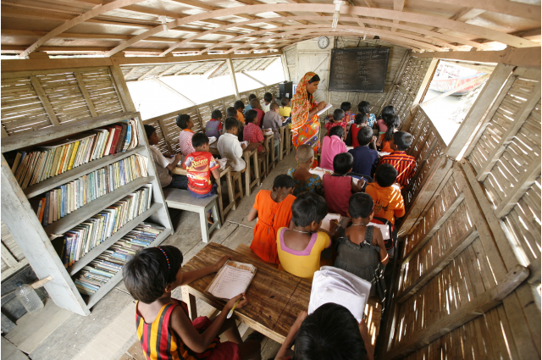
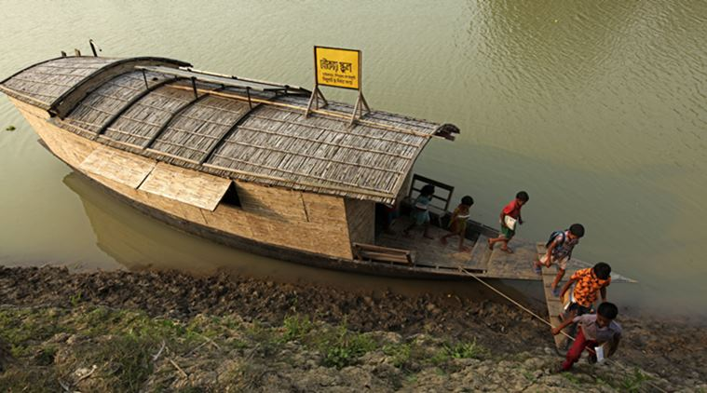
Get started
Watch this video
27
Notes:
Show learners the clip.
Ask learners to summarise all the things that the children and adults were learning about.
Discuss the benefits of the approach being taken in the film: e.g.
· Access to education
· Relevance of what was being taught
· The importance of life-long learning
· The wider impact of the life skills being taught
· The additional benefits brought by this initiative e.g. solar lighting.

Slide 28
Get started
Discuss:
What are the similarities between the learning of the young people in the clip and your learning?
What are the differences?
28

Slide 29
Get started
What should YOUR learning look like?
What should you learn?
What kind of place would you learn in?
Over to you…
29
Notes:
Ask learners to work in groups.
Give each group a piece of flipchart paper and pens
Learners have just seen an educational approach that is tailored to meet the specific needs of a group of learners in another part of the world.
Ask them to think about their own learning. What would an ideal educational experience look like for them?
Ask them to consider:
· What do they need to learn about?
· How should the learning be delivered?

Slide 30
Take it further
Explore the issues raised in On the Way to School using the resources on the Oxfam Education website.
Find out more about the annual Send My Friend to School campaign which advocates for the right to education for all children. Classroom resources and action ideas can be found on their website www.sendmyfriend.org
Explore the right to education and the way it impacts on life chances with Scotdec’s Pants to Poverty resource
Explore the issues faced by disadvantaged young people in Scotland when it comes to accessing education; such as young carers, and those with additional needs.
30

Slide 31
Want more?
Check out these additional resources for this goal:
http://worldslargestlesson.globalgoals.org/global-goals/quality-education/
http://www.teachglobalambassadors.org/curriculum-areas
https://www.mygov.scot/young-carer-support/
https://education.gov.scot/scottish-education-system/cld/About%20Community%20Learning%20and%20Development
31

Slide 32
Goal 5: Gender Equality
Understanding the SDGs
This goals aims to:
Achieve gender equality and empower all women and girls
32
32

Slide 33
Get started
What do we mean by ‘gender equality’?
‘Gender equality’ is when everyone has the same rights and opportunities regardless of their gender, and all are valued equally by everyone.
33

Slide 34
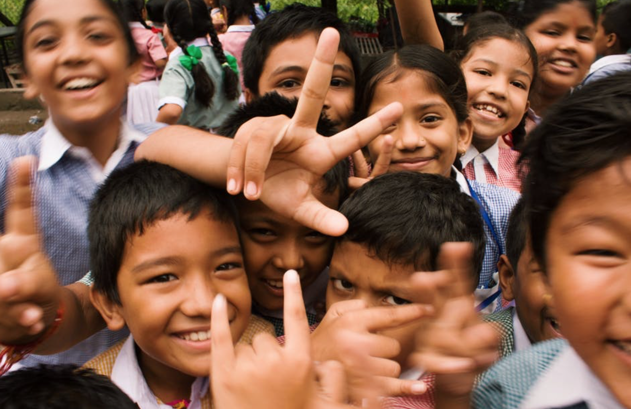
Get started
Watch this clip
But it’s not just about
empowering women
and girls…
34

Slide 35
Take it further
Visit www.intofilm.org for film resources including the ‘Bechdel Test’, used to analyse how women are represented in film and a guide to He Named Me Malala.
Use the resources and video clips on the Education Scotland Improvement Hub to explore gender balance issues with learners.
Explore how parental and societal attitudes influence gender roles and expectations.
35

Slide 36
Want more?
Check out these additional resources for this goal:
http://worldslargestlesson.globalgoals.org/global-goals/gender-equality/
http://www.teachglobalambassadors.org/curriculum-areas
http://www.heforshe.org/en/newsroom/news/heforshe-equality-stories
36

Slide 37
Goal 6: Clean Water and Sanitation
Understanding the SDGs
This goals aims to:
Ensure availability and sustainable management of water and sanitation for all
37
37

Slide 38
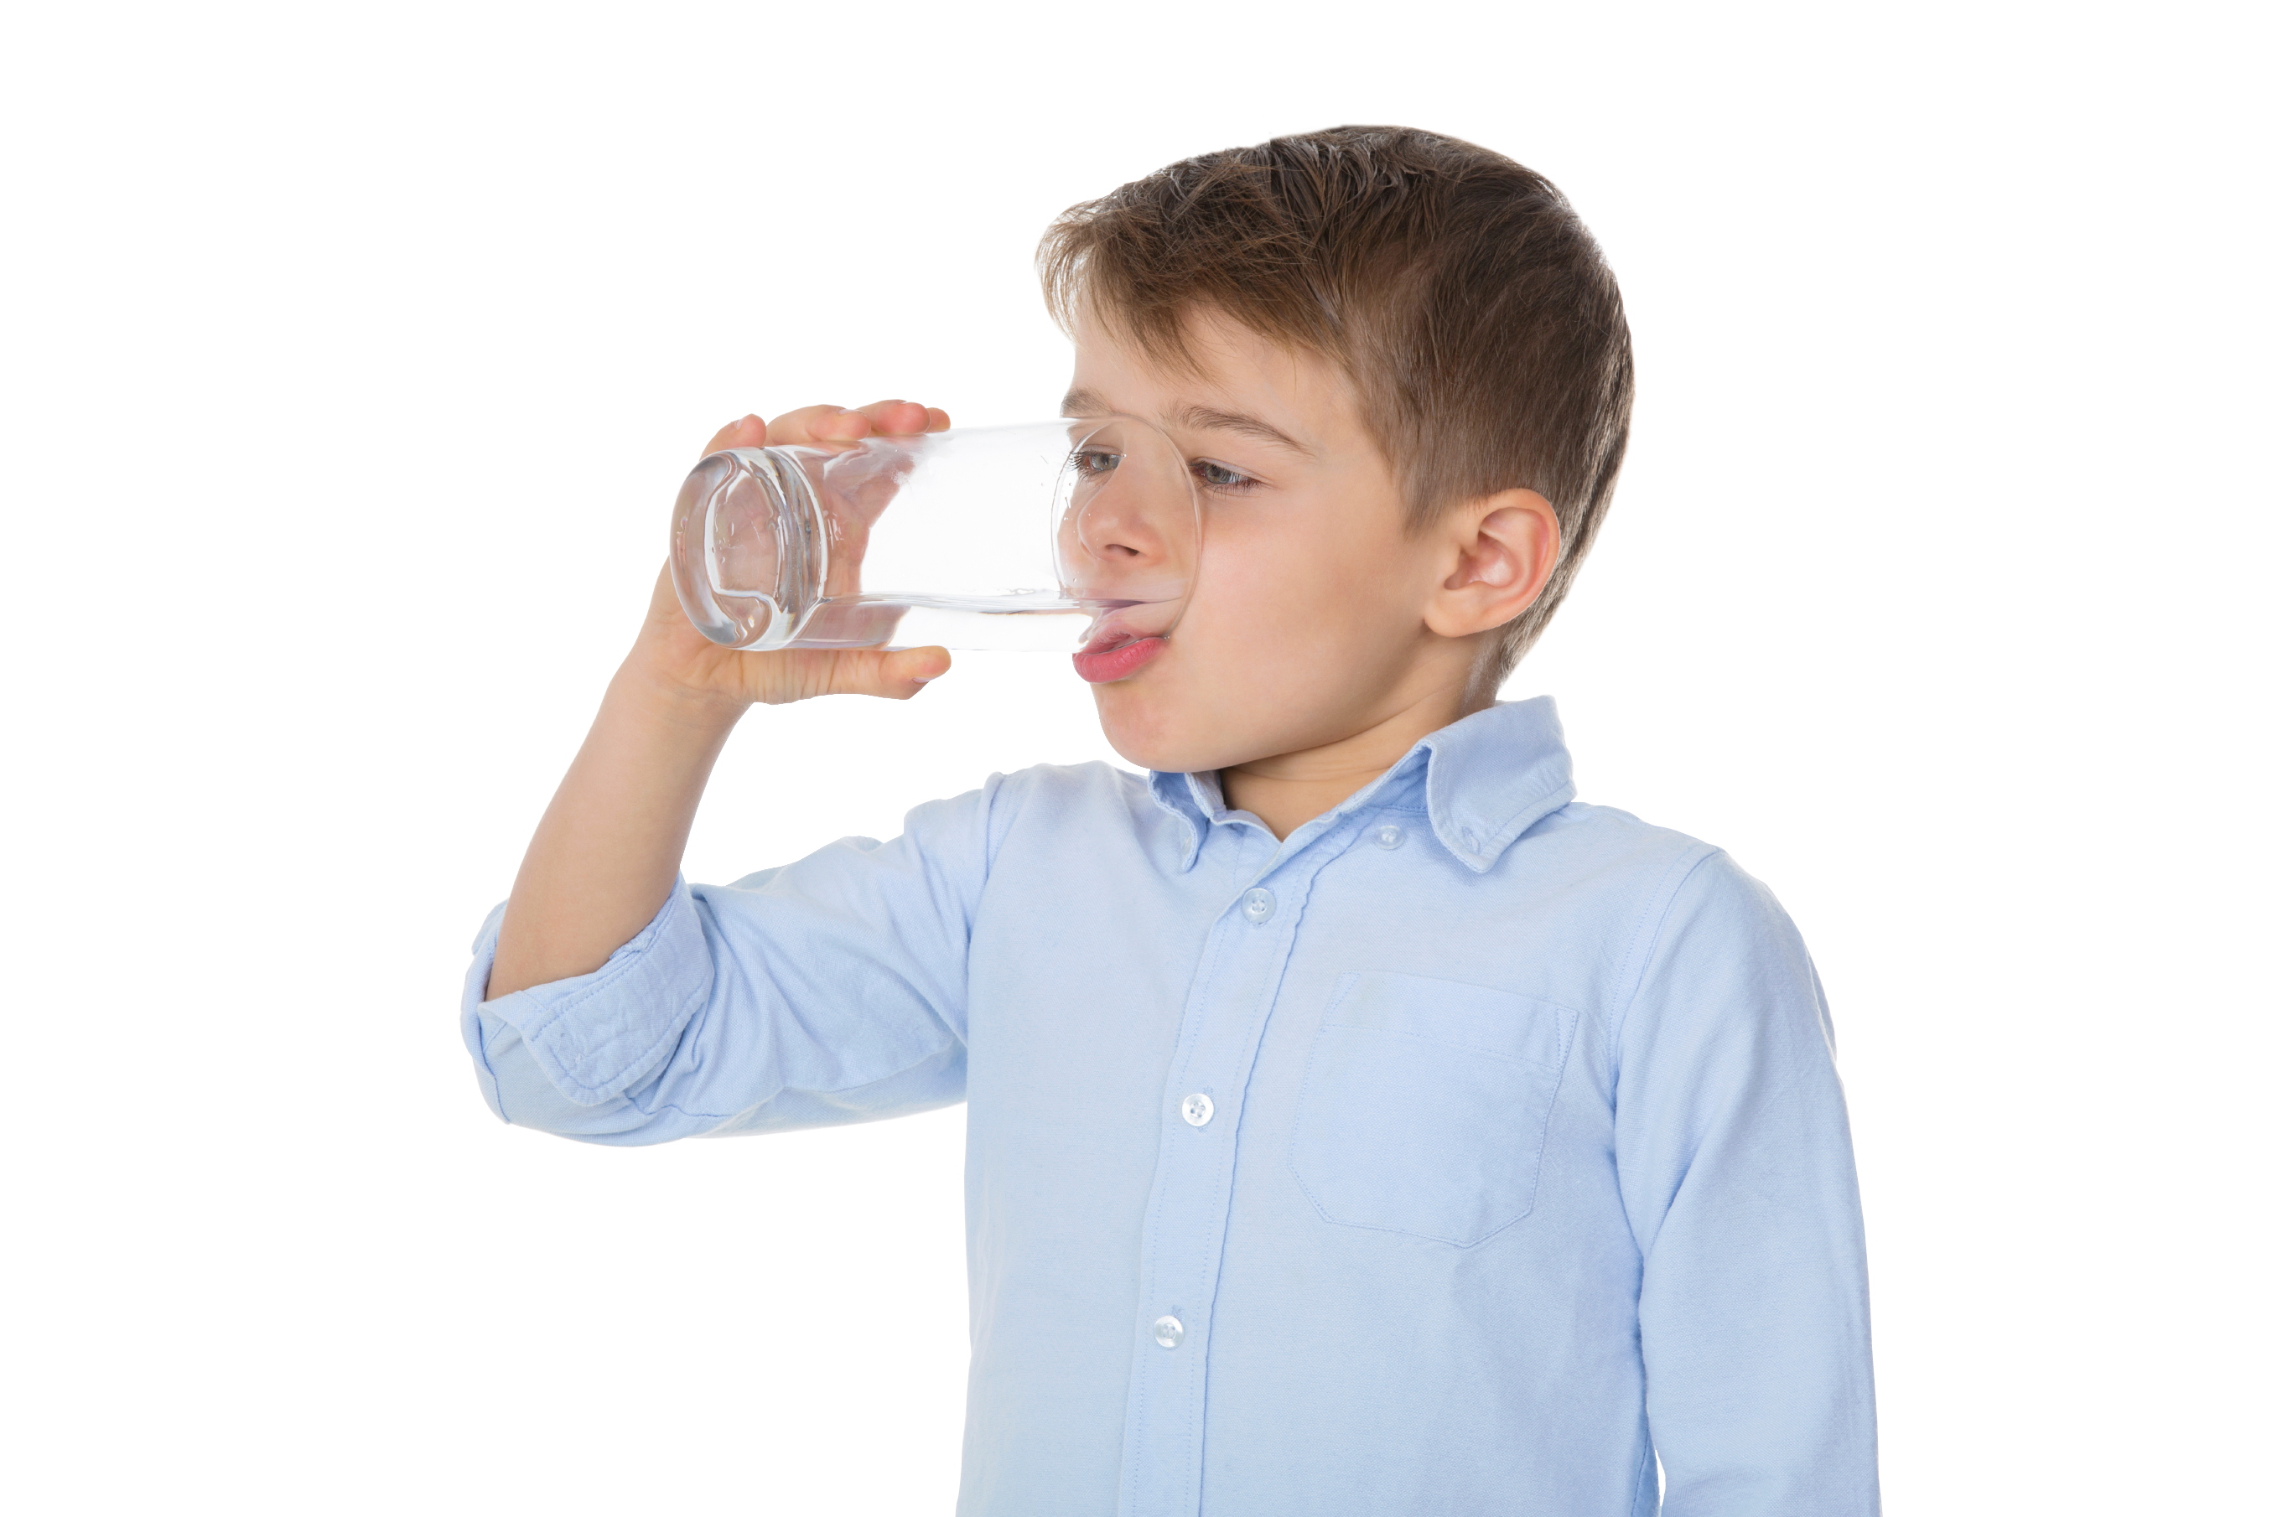
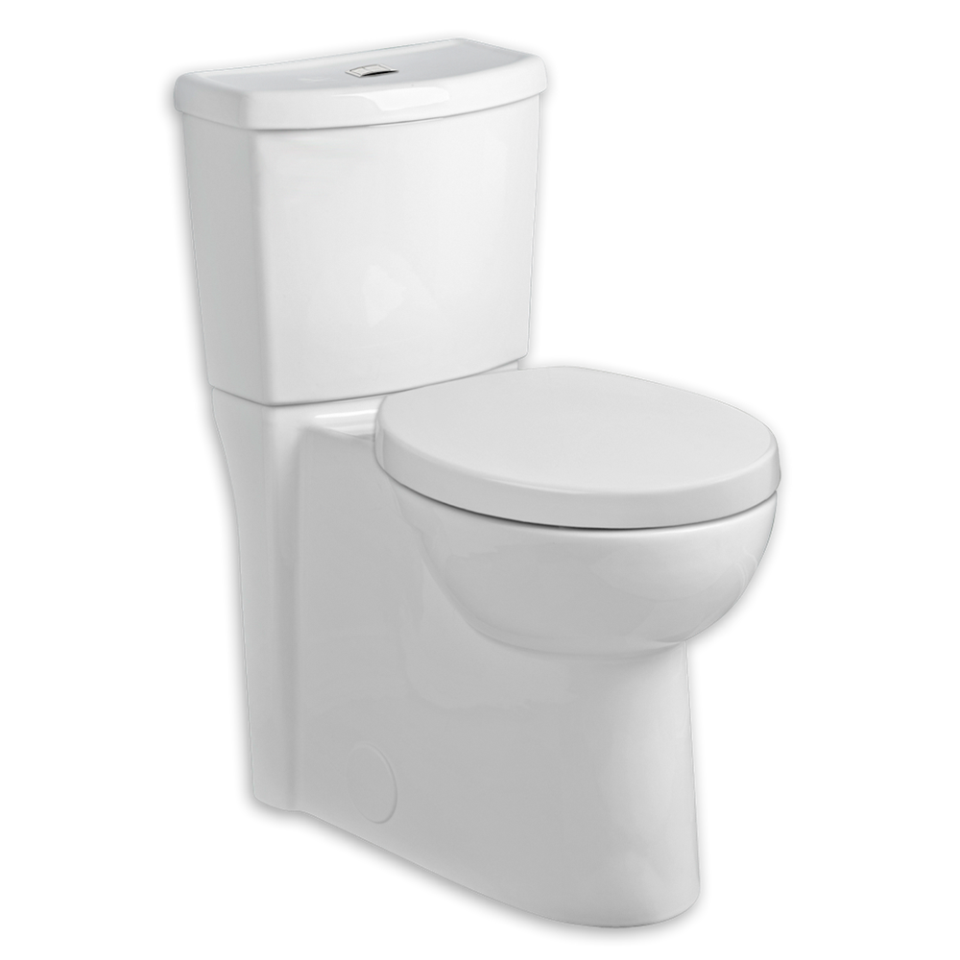
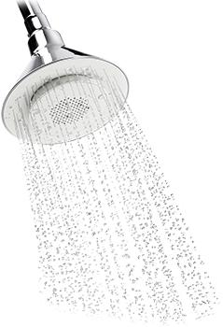
Get started
Make a note of the activities you have done today where you have used water. How much water do you think they used?
2 litres (= 8 glasses)
24 litres (tap running)
10 litres/ flush
15 litres/ minute
Now have a look at the 2 litre bottle on your table.
How many of these would you need to hold the water you use every day?
An average person in the UK uses 150 litres of water every day.
How would you feel if you had to collect that much water every day?
38
Notes:
Ask learners to think about:
· How they use water every day
· How much water they use every day
· What it would feel like to have to carry that amount of water every day.
Have them lift the 2-litre bottle and imagine how it would feel to have to carry over 75 of those over several miles every day!

Slide 39
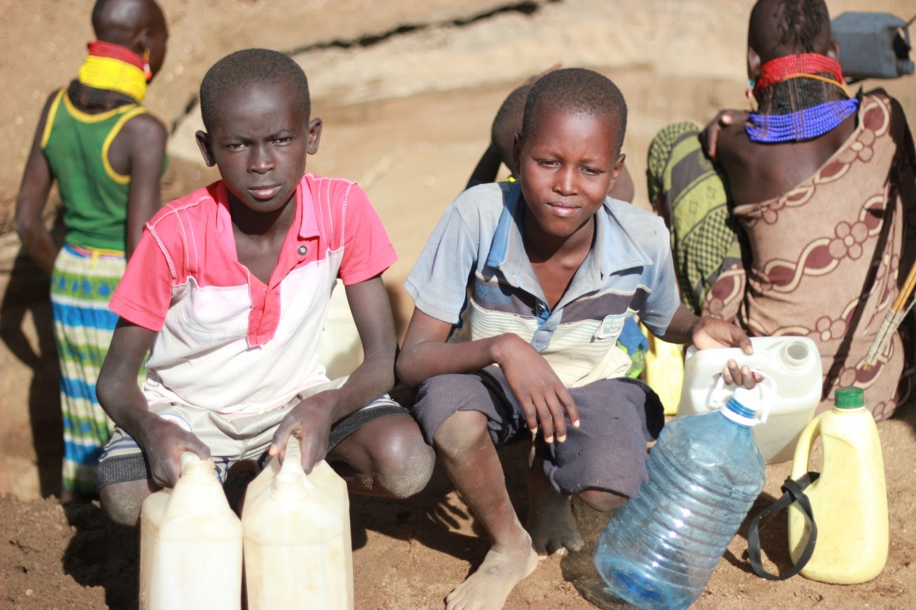
Get started
There are 2.4 billion people in the world today who do not have water piped to or close to their homes.
They have to collect the water and carry it back to their homes on a daily basis. This can mean walking for several miles.
Often, it’s children & women who do this. What does this mean for them?
39
Notes:
Discuss the UNICEF figures. Do they hold any surprises?
Use the next slide to discuss the causes of food insecurity in more detail.

Slide 40
Get started
Water usage guide
How much do you use?
Cleaning teeth 0.25l
Shower 15l
Toilet flush 10l
One saucepan 1l
Cup of tea 0.25
One dishwasher load 15l
Washing up by hand 8l
Washing machine load 80l
Clothes washing by hand 25l
1 bucket = 4 litres
40
Notes:
Discuss the UNICEF figures. Do they hold any surprises?
Use the next slide to discuss the causes of food insecurity in more detail.

Slide 41
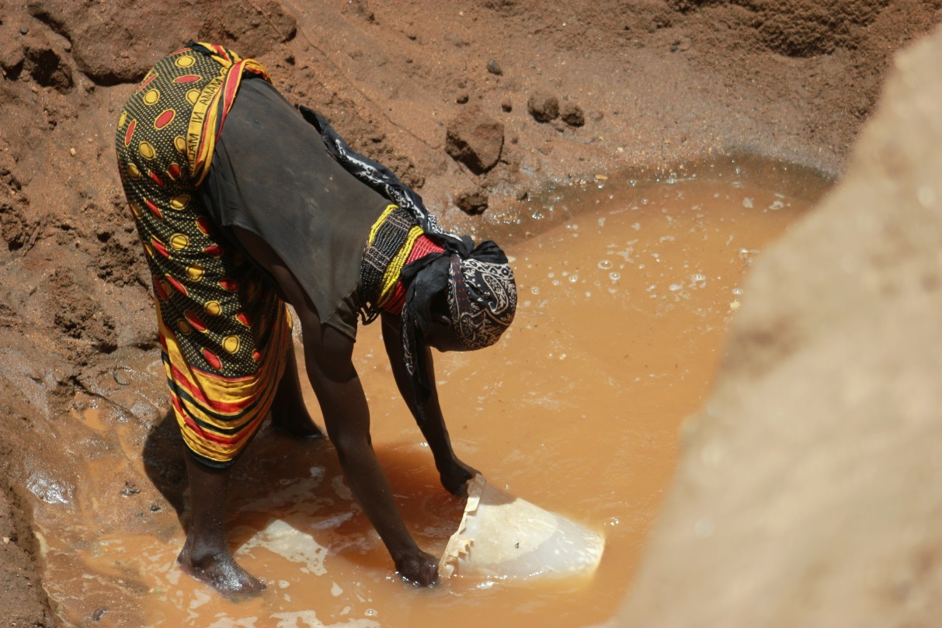
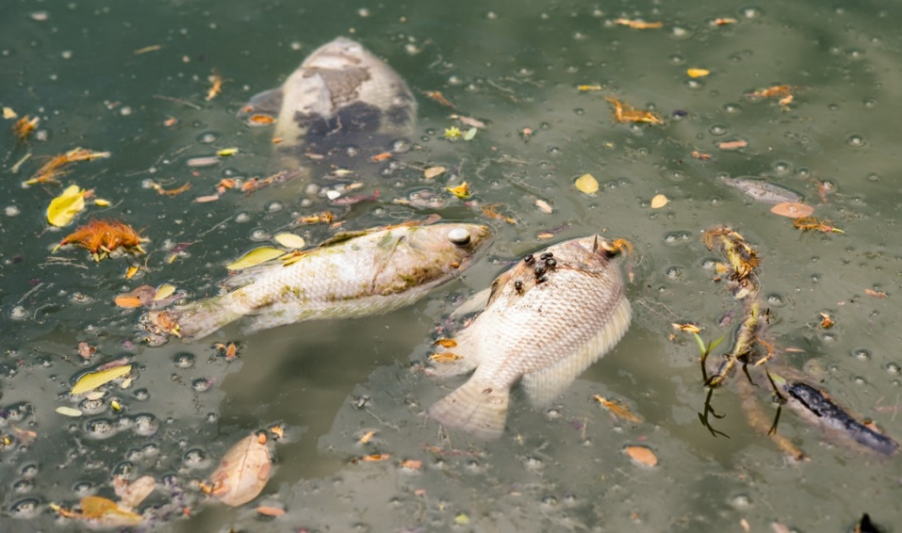
Get started
Access to water isn’t the only issue. Very often, the water available isn’t safe to drink.
Clean water isn’t just vital for human health. All of the natural world depends on it.
41
Notes:
Discuss the impact of clean water on all living things.

Slide 42
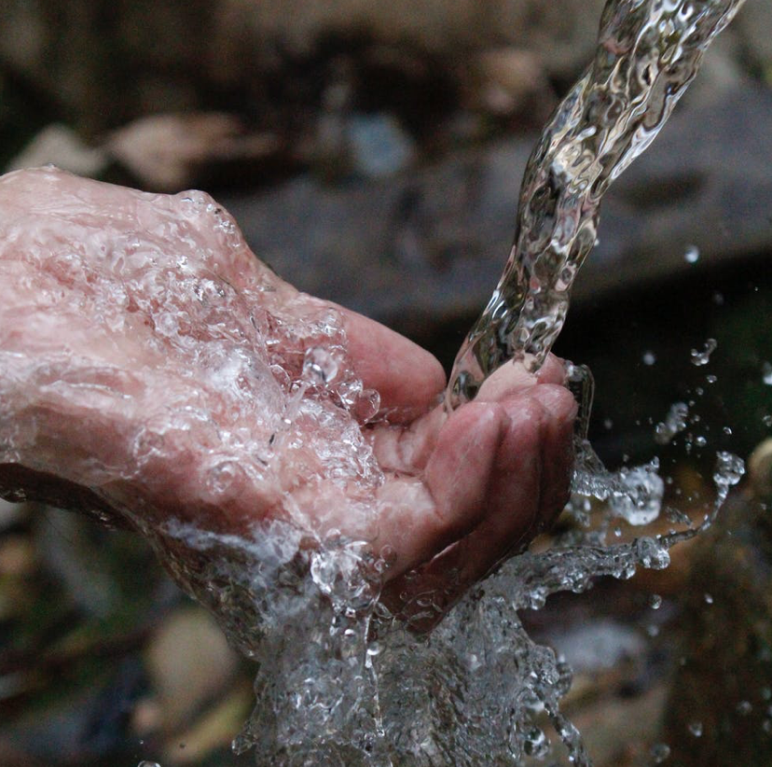
Get started
Over to you:
Arrange the statements into two piles:
1. Things I can directly prevent
2. Things I can’t directly prevent
What could we do about pile 2?
42
Notes:
Divide learners into groups.
Give each group a copy of Appendix 2: Causes of water pollution from this document: http://cdn.worldslargestlesson.globalgoals.org/2016/06/14-Clean-Water-for-All.pdf
Get them to tear or cut the statements up.
Ask them to arrange the statements into two piles as per the instructions on the slide.
Ask them to explain the reasons for their decisions.
What could they do to influence the second pile? E.g. consumer pressure, awareness-raising, further investigation of the issue etc.

Slide 43
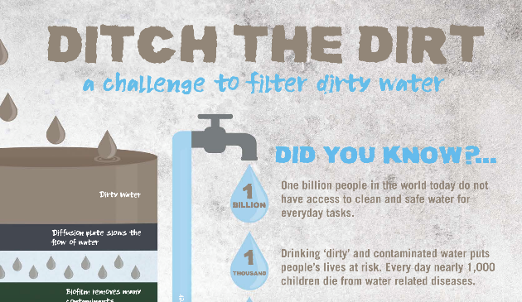
Take it further
Keep a water usage diary and compare it with a young person in Malawi. www.scotdec.org.uk/resources
Investigate ways of making dirty water cleaner with the Ditch the Dirt STEM challenge from https://practicalaction.org/ditch-the-dirt
Hold a ‘Water Week’ in your school using Oxfam’s dedicated resources and take action for change. www.oxfam.org.uk/education
43

Slide 44
Want more?
Check out these additional resources for this goal:
http://worldslargestlesson.globalgoals.org/global-goals/clean-water-sanitation
http://www.teachglobalambassadors.org/curriculum-areas
https://www.keepscotlandbeautiful.org/sustainable-development-education/eco-schools/ten-topics/water/
44

Slide 45
Goal 7: Affordable and Clean Energy
Understanding the SDGs
This goals aims to:
Ensure access to affordable, reliable, sustainable and modern energy for all
45
45

Slide 46
Think about your typical day…
List all of the things you do that need an external energy source to make them happen.
The following headings might be of use:
Getting up in the morning and getting ready for school
Getting to school
At school
On the way home
At home
Getting ready for bed
Decide which of these activities are essential or non-essential.
Get started
46
Notes:
Get learners to reflect on their experience of daily energy use (e.g. using a shower, getting on diesel-powered buses, charging mobile phones/watching TV using electricity generated from coal etc.).
Encourage them to think about ‘indirect’ energy use such as eating food that’s been transported thousands of miles, wearing clothes that have been made in other countries etc.)

Slide 47
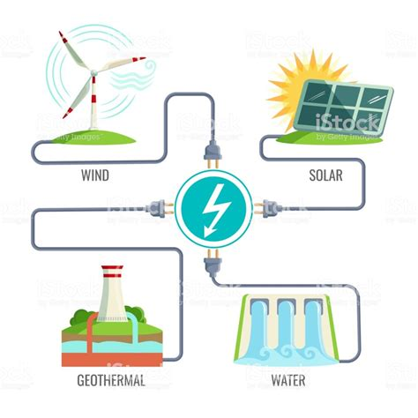
Get started
Where does the energy for all your activities come from?
Fossil fuels?
Renewable sources?
What are the pros and cons of each energy type?
47
Notes:
Ask learners to define what we mean by ‘fossil fuel’ and ‘renewable energy’.
Now ask learners to investigate each energy type in their groups. What are the pros and cons of each? (e.g. reliability, finite/inexhaustible, pollution, climate impact, efficiency, cost, controversy.)

Slide 48
Get started
The day the fossil fuels ran out.
Over to you.
Tell the story of what happened next...
48
Notes:
Ask learners to imagine what will happen when fossil fuels finally do run out.
Using words or pictures, get them to tell the story of what happened next.
Prompts could include:
- Alternative energy generation solutions
- Curbing energy use
- Innovative solutions to food production, lighting, heating etc.

Slide 49
Take it further
Use the Smoky Homes project to explore the issues faced by the 3 billion people globally who cook on open fires or traditional cook stoves.
Take the STEM Wind Power Challenge where pupils design and build a simple wind powered machine that can lift a cup off the floor.
Discover how energy access via the National Grid differs between the UK and Kenya. Pupils look at renewable energy solutions & have the opportunity to design & build a wind turbine.
49

Slide 50
Want more?
Check out these additional resources for this goal:
http://worldslargestlesson.globalgoals.org/global-goals/modern-energy/
http://www.teachglobalambassadors.org/curriculum-areas
https://www.keepscotlandbeautiful.org/sustainable-development-education/eco-schools/ten-topics/energy/
50

