Slide 1





resources | projects | professional learning
The Global Goals For Sustainable Development
starter activities
scotdec.org.uk
@scotdeclearning
/scotdeclearning

Slide 2


Goal 8: Decent work and economic growth
Understanding the SDGs
This goals aims to:
Promote sustained, inclusive and sustainable economic growth, full and productive employment and decent work for all
2
2

Slide 3





Get started
Imagine you’re going to buy a new mobile phone…
How much would the following influence your choice?
Consider each of the issues in turn. Stand at different points in a line from one end of the room to the other depending on how much you would think about it before making your decision.
3
Notes:
Before the lesson begins, create 3 ‘markers’ across your learning space where learners will stand. Label each marker with one of the following: ‘Matters a lot’ ‘Not bothered either way’ ‘Not in the slightest’. Tell learners that you will read out each of the issues on the next slide in turn, and they have to decide how much each statement matters to them. They will show this by standing at the marker that they feel applies to them the most.

Slide 4

Get started
Which of the following matters to me
about my mobile phone?
Where the product was manufactured?
How far has it had to travel?
The age and type of person making the product?
How much that person was paid for their work?
How much energy you need to charge the phone?
How many functions it has that I will use?
How long will I keep it for?
What happens to my phone when you get rid of it?
Will the phone be recycled or parts reused?
4

Slide 5



Take it further
Use SCOTDEC’s mobile phone activity to explore more about the global social, economic and environmental impacts of mobile technology.
Find out more about life as a worker in the clothes industry using the Scotdec Active Global Citizens resource www.scotdec.org.uk/resources
Go on to explore the role Fairtrade plays in improving working conditions http://www.scottishfairtradeforum.org.uk/
5

Slide 6


Want more?
Check out these additional resources for this goal:
http://worldslargestlesson.globalgoals.org/global-goals/good-jobs-and-economic/
http://www.teachglobalambassadors.org/curriculum-areas
6

Slide 7

Goal 9: Industry, innovation and infrastructure
Understanding the SDGs
This goals aims to:
Build resilient infrastructure, promote inclusive and sustainable industrialisation and foster innovation
7
7

Slide 8


Get started
Your mission today is to build a structure strong enough to withstand an ‘earthquake’.
You can only use the materials given to you, and there will be a time limit for you to design and build your structure.
Your teacher will test each structure using the Amazingly Infallible Hi-Tech Earthquake-o-Matic. This is a sophisticated device; developed by a team of top scientists.
8

Slide 9
Get started
Discuss
Why did some structures withstand the test better than others?
How did you feel about the materials you were given?
How do you think this activity relates to Goal 9?
9

Slide 10
Take it further
Ask pupils to design a sustainable school.
Investigate the possible challenges for developing countries that are reliant on farming as their sole source of income.
Challenge pupils to set up a sustainable enterprise activity exploring how businesses are run and the factors that result in a successful business.
Invite in the councils energy advisor to help pupils understand what a sustainable building is.
Case Study - pupils choose a developing country and explore why reliable buildings, roads and power supplies are essential in their development.
Research internet access in Scotland. Compare and contrast it to other countries in the world (e.g. France/Spain/Germany/ Italy/China for Modern Languages). Examine what effect poor internet access can have on education, jobs etc.
10

Slide 11
Take it further
Find out more about the science behind the ‘Spaghetti Structures’ activity https://learning-resources.sciencemuseum.org.uk/resources/spaghetti-structures/
Use Oxfam’s Stories from Haiti to explore the resilience and challenges faced by those caught up in the devastating earthquakes in 2010 https://www.oxfam.org.uk/education/resources/stories-from-haiti-7-11
With older pupils you could explore the concept of technology justice and the global right to access sustainable technology https://practicalaction.org/schoolstechnologyjustice
11

Slide 12
Want more?
Check out these additional resources for this goal:
http://worldslargestlesson.globalgoals.org/global-goals/innovation-and-infrastructure/
http://www.teachglobalambassadors.org/curriculum-areas
http://www.innovationmanagement.se/2017/07/31/the-5-most-innovative-renewable-energy-sources/
12

Slide 13

Goal 10: Reduced inequalities
Understanding the SDGs
This goals aims to:
Reduce inequality within and among countries
13
13

Slide 14

Get started
True…or false?
1. The 85 richest people in the world have as much wealth as the poorest half of all humanity, 3.5 billion people.
2. The four richest families in Scotland are worth £1 billion more than the poorest 1 million people in Scotland.
3. Almost one in four children in Scotland (230,000) is officially recognised as living in poverty.
4. In most developed countries the unemployment rate for people with disabilities is at least twice that for those who have no disability.
5. By 2040, it is estimated that over 25% of Europeans are expected to be at least 65 years old.
14

Slide 15
Get started
True…or false?
6. In the UK the unemployment rate for people aged 16-24 is 14.4%. The overall unemployment rate is 5.7%.
7. Globally, women occupy less than a 25% of all seats in parliament.
8. In the UK twice as many women as men rely on state benefits.
9. In the UK two thirds of pensioners living in poverty are women.
10. In Europe, easy access to green spaces levels improves the health of poorer people by as much as 40%.
11. In the USA, people living close to public transport can access up to three times as many jobs.
15

Slide 16
Get started
Answers:
1) The 85 richest people in the world have as much wealth as the poorest half of all humanity, 3.5 billion people.
True. From a report by Oxfam UK in 2014. You can read more from their report here:
http://www.theguardian.com/business/2014/jan/20/oxfam-85-richest-people-half-of-the-world
2) The four richest families in Scotland are worth £1 billion more than the poorest 1 million people in Scotland.
True. https://www.independent.co.uk/news/uk/home-news/scotlands-four-richest-families-worth-1-billion-more-than-poorest-20-of-population-a6685411.html
3) Almost one in four children in Scotland (230,000) is officially recognised as living in poverty.
True. http://cpag.org.uk/scotland/child-poverty-facts-and-figures
4) In most developed countries the official unemployment rate for persons with disabilities of working age is at least twice that for those who have no disability.
True. Business Disability Forum. http://businessdisabilityforum.org.uk
6) By 2040, it is estimated that over 25% of Europeans are expected to be at least 65.
True. US Census Bureau, 2008. http://www.efa.org.uk/pages/older-people-global-perspective-.html
16

Slide 17
Get started
Answers:
7) In the UK the unemployment rate for people aged 16-24 is 14.4%. The overall unemployment rate now stands at 5.7% of the total working population.
True. Office for National Statistics, 2015. http://www.theguardian.com/society/2015/feb/22/youth-unemployment-jobless-figure
8) Globally, women still occupy less than 25% of all seats in parliament.
True. Inter-Parliamentary Union, 2015. http://www.theguardian.com/global-development/datablog/2015/mar/08/international-womens-daynumber-of-female-lawmakers-doubles-in-20-years
9) In the UK twice as many women as men rely on state benefits.
True. Mordaunt et al, ‘One in Four’, 2003.
10) In the UK two thirds of pensioners living in poverty are women.
True. Mordaunt et al, ‘One in Four’, 2003.
11) In Europe, easy access to green spaces levels off inequalities in health between the rich and poor by as much as 40%, when compared with those with poorer access to green spaces.
True. Centre for Research on Environment, Society and Health, 2015.
http://fashion.telegraph.co.uk/article/TMG11551673/How-green-spaces-stop-the-wealth-gap-becoming-the-health-gap.html
12) In the USA, people living close to public transport can access up to three times as many jobs per square mile.
True. American Public Transport Association, 2013.http://www.apta.com/resources/statistics/Documents/NewRealEstateMantra.pdf
17

Slide 18
Get started
‘To me, inequality means…’
What does ‘inequality’ mean to you?
Share your thoughts:
  In 250 words or less of prose
  Through images and captions
  In a poem
18
Notes:
Real-life examples are particularly welcome but care should be taken to avoid embarrassing learners for whom inequality may be part of their daily lives.

Slide 19
Get started
Over the next few days…
Identify something that represents inequality in your local area.
It could be something you see on your journey to and from from school.
Describe the inequality and its impact.
How could we solve this inequality?
For example:
Bushes and hedges growing over the pavement which would hamper the progress of the visually impaired.
Steps up to a public building or space which would hamper the progress of those in wheelchairs, with pushchairs, or people who have difficulty walking.
Shops or green spaces that are only accessible by car, meaning those who rely on public transport cannot access them (a majority of these are often elderly or unemployed)
19
Notes:
Again, care should be taken to avoid embarrassing learners for whom inequality may be part of their daily lives.

Slide 20
Take it further
Discover the journey of chocolate from bean to bar, from Ghana to Scotland with Pa Pa Paa. The web based resource includes photos, case studies and illustrates the difference Fairtrade can make. http://www.papapaa.org/ks2/index.html
Alternatively explore issues of fairness, equality and community through tax fairness using a ‘Philosophy for Children’ approach from Action Aid. https://www.actionaid.org.uk/school-resources/resource/tax-fairness-and-philosophy-for-children
20

Slide 21
Take it further
Discuss the following quote from Sir Harry Burns, former Chief Medical Officer for Scotland. Is he right?
Why? Why not? What can/should be done about it?
“Health inequalities are the biggest issue facing Scotland just now, because not only are health inequalities a problem but health inequalities are really a manifestation of social inequality.
Social complexity, social disintegration… drives things like criminality, it drives things like poor educational attainment, it drives a whole range of things that we would want to see different in Scotland. The more attention we can get paid to the drivers of that situation, the better.”
21

Slide 22
Want more?
Check out these additional resources for this goal:
http://worldslargestlesson.globalgoals.org/global-goals/reduced-inequalities/
http://www.teachglobalambassadors.org/curriculum-areas
https://www.amnesty.org/en/latest/education/
22

Slide 23

Goal 11: Sustainable cities and communities
Understanding the SDGs
This goals aims to:
Make cities and human settlements inclusive, safe, resilient and sustainable
23
23

Slide 24



Get started
Think about where you live…
Individually…
Use words or pictures to describe your home.
As a group…
Use words or pictures to describe your neighbourhood.
24
Notes:
It’s important to be sensitive to the background and home circumstances of the learners involved when introducing these activities.

Slide 25
Get started
What do we mean by…
‘Neighbourhood’?
‘Community’ ?
How do you feel about the area where you live?
Does it provide what you need?
Use words or pictures to describe your connection to it.
25
Notes:
It’s important to be sensitive to the background and home circumstances of the learners involved when introducing these activities.
You may wish to refer to the UN Convention on the Rights of the Child (https://www.unicef.org.uk/what-we-do/un-convention-child-rights/) to encourage learners to think about their rights when considering the second bullet point as to whether their area meets their needs.

Slide 26
Get started
Over to you…
How would you improve where you live? Think about things like:
Are there enough jobs?
Are you close to healthcare (e.g. doctor’s surgery, hospital, dentist?
Can young people walk to school safely?
Can you walk safely with your family or friends at night?
How far is the nearest public transport?
What is the air quality like?
What are your shared public spaces like?
Can you get healthy, fresh food?
26

Slide 27
Take it further
Consider the UN Convention on the Rights of the Child and what this means for a sustainable community or city. https//www.unicef.org.uk/what-we-do/un-convention-child-rights/
Find out how families across the world really live with Dollar Street. https://www.gapminder.org/dollar-street/matrix
Use Action Aids resources on Brazil and India to explore life around the world in big cities. https://www.actionaid.org.uk/school-resources/search
27

Slide 28
Want more?
Check out these additional resources for this goal:
http://worldslargestlesson.globalgoals.org/global-goals/sustainable-cities-and-communities/
http://www.teachglobalambassadors.org/curriculum-areas
http://sustainablefoodcities.org/
https://beta.gov.scot/policies/european-structural-funds/sustainable-cities/
28

Slide 29

Goal 12: Responsible consumption and production
Understanding the SDGs
This goals aims to:
Ensure sustainable consumption and production patterns
29
29

Slide 30







Get started
Our food choices can change the world!
Watch this video
Make a note of anything in the video that you think relates to sustainability.
Discuss your findings as a group.
Discuss your findings as a whole class.
30

Slide 31
Get started
Our food choices can change the world!
Where it was grown
Worker’s rights
Brand
Price
Fairly traded
Quality
Organic
Local
31

Slide 32
Get started
32
Notes:
Discuss the poster as a class to help illustrate the way in which our food choices link to all 17 Goals.
Explain that learners will now be asked to think about their own food choices and how they can help to achieve the Goals.

Slide 33
Get started
Every Plate Tells a Story…
You will need:
Your meal photo or picture that you brought with you.
A Global Goals Grid Poster (to remind you of all the Goals)
An ‘Every Plate Tells a Story’ results sheet
An ‘Every Plate Tells a Story’ instructions.
An ‘Every Plate Tells a Story’ worksheet.
Watch this clip
33
Notes:
Give learners the following materials from this resource:
http://cdn.worldslargestlesson.globalgoals.org/2017/07/Every-Plate-Tells-A-Story-PP-May-181.pdf
Appendix A: the Global Goals Grid Poster
Appendix C: ‘Every Plate Tells a Story’ worksheet
Appendix D: ‘Every Plate Tells a Story’ instructions
Appendix E: ‘Every Plate Tells a Story’ results sheet
· Ask learners to look at the photo/picture that they have brought of a recent or favourite meal.
· Explain that they are going to investigate it and discover its story.
· Give learners the ‘Every Plate Tells a Story’ resources and ask them to look at the Results sheet first to gain an understanding of the questions they are to answer.
· Ask learners to then read through the Instructions and start answering the questions on the Results sheet. Let them know that they can make educated judgments for answers if they unsure as to specifics. Encourage the use of additional resources such as maps, websites, and books to help learners determine the answers.
Once they have done this ask them to fill in their results on the Worksheet.
Ask them to leave the ‘Pledge’ section for now.

Slide 34

Get started
Make a Pledge…
What’s a ‘pledge’?
Use your answers to guide your pledge.
Share your pledge.
34
Notes:
Introduce the word ‘pledge’ and the way pledges are connected to accomplishing goals.
Discuss how answers from the activity can be used to guide a formal pledge. Learners may share ideas for pledges.
To complete the activity sheet, ask learners to determine and record their own formal pledges.
***They can share their learning and pledges with others using video via: https://flipgrid.com/globalvoice***

Slide 35
Take it further
We all use clothes, food and technology every day. Find out more about where they came from, who made them and what impact they have on the environment with Scotdec’s Active Global Citizens resource www.scotdec.org.uk/resources
Visit https://www.zerowastescotland.org.uk/food-waste/teaching-resources and use their school resources to explore the issue of food waste.
Waste…or unused resource? Find out more with Eco-Schools Scotland’s resources.
Investigate the concept of the ‘circular economy’ and how product design is helping to achieve Goal 12.
35

Slide 36
Want more?
Check out these additional resources for this goal:
http://worldslargestlesson.globalgoals.org/global-goals/responsible-consumption/
http://www.teachglobalambassadors.org/curriculum-areas
https://www.ellenmacarthurfoundation.org/programmes/education/
schools-colleges
36

Slide 37

Goal 13: Climate Action
Understanding the SDGs
This goals aims to:
Take urgent action to combat climate change and its impacts
37
37

Slide 38

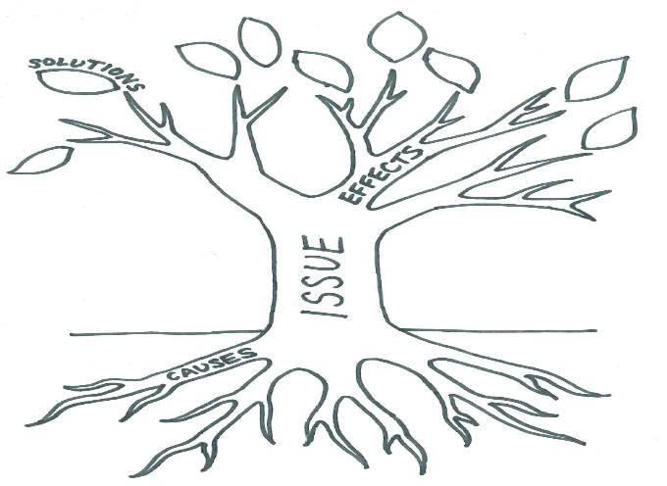
Work in your groups to investigate climate change:
What is it?
What causes it?
How will it affect:
the planet
wildlife
people?
Write your findings on the corresponding parts of your Issues Tree.
Get started
38
Notes:
Ask learners to work in their group to investigate and discuss:
· What is climate change?
· What causes climate change?
· How does/will climate change affect:
- the planet
- wildlife
- people
Encourage the use of websites, books and other sources of information. Ask learners to write their findings on the Issues Tree as per the instructions on the accompanying slide.
Ask each group to share their findings with the class.
Reflect on the findings as a class. What did they find out that surprised/did not surprise them?
(One effective strategy is to get learners to focus on how their personal activities contribute to climate change. A possible method is to get them to reflect on their experience of daily energy use (e.g. diesel-powered buses, charging mobile phones using electricity generated from coal etc) or where their food comes from and the impacts this has (e.g. deforestation to create farmland, the transportation of food across thousands of miles etc.)
Now ask learners to think about the effects of climate change (e.g. flooding, drought, rising temperatures, threat to human and animal life, species extinction, food shortages etc.). Write these on the branches.
Finally…get learners to think about solutions: either ones they can take themselves (i.e. asking whether they really need to engage in certain energy-use activities, or eat food that travels across the globe to get to them) or ones that require external input (e.g. developing and harnessing more renewable energy sources, designing energy-efficient versions of existing technology, exploring seasonal/local food offerings etc.) )

Slide 39

Get started
Over to you…
What’s being done to combat climate change: - internationally?
- here in Scotland?
What can I do to combat climate change?
Write your findings on the corresponding parts of your Issues Tree
39
Notes:
Show the second ‘Get Started’ slide.
Ask learners to work in their groups to investigate and discuss:
· What is already being done to combat climate change internationally?
· What is already be in done to combat climate change here in Scotland?
(Learners may wish to consider the contributions being made by:
- Governments
- Non-governmental organisations such as charities, pressure groups etc.
- Influential individuals e.g. celebrities, campaigners.)
· What can I personally do to combat climate change?
Get the class to share their findings and reflect on the solutions they come up with.

Slide 40

Take it further
Windows on the World from Christian Aid https://www.christianaid.org.uk/resources/get-involved-locally/window-world-climate
Floating Gardens Challenge from Practical Action https://practicalaction.org/floatinggardenchallenge
The Climate Change challenge from Oxfam Education https://www.oxfam.org.uk/education/resources/climate-challenge-7-11
Discover more about climate change and personal food choices with the Eat Low Carbon interactive quiz.
40

Slide 41
Want more?
Check out these additional resources for this goal:
http://worldslargestlesson.globalgoals.org/global-goals/protect-the-planet/
http://www.scotdec.org.uk/images/resources/youth/GYW_Sustainable_foods.pdf
http://www.teachglobalambassadors.org/curriculum-areas
https://www.oxfam.org.uk/education/resources/making-a-meal-of-it
https://www.keepscotlandbeautiful.org/sustainable-development-education/food-and-the-environment/
http://www.scotdec.org.uk/resources/global-youth-work/chocolate
https://www.wwf.org.uk/get-involved/schools/resources/climate-change-resources
https://practicalaction.org/climate-change-resources
https://www.tes.com/articles/climate-change-resources
41

Slide 42

Goal 14: Life below water
Understanding the SDGs
This goals aims to:
Conserve and sustainably use the oceans, seas and marine resources for sustainable development
42
42

Slide 43
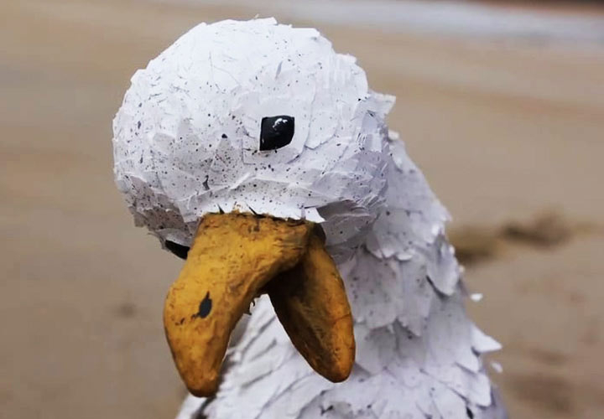


Get started
Watch this clip
Reflection…
What did you think about the film?
Why did the bird die?
What action can you take to save the bird?
43
Notes:
Play the ‘Sea Me’ animation.
Give each learner a copy of the worksheet from the ‘Sea Me’ resource: http://www.stridemagazine.org.uk/images/summer-2018/Activity_4_Sea_Me.pdf
Ask learners to individually fill in Questions 1 & 2 on the template.
Once finished they can share their template with the person sitting next to them.
Discuss their answers as a class. The template focuses on key questions:
1. What did you think about the film?
2. Why did the bird die?
Check that pupils understand where the rubbish in our seas and on our beaches comes from. Some ideas include:
1. When litter is dropped directly on beaches and washed into the sea.
2. Hundreds of miles from the sea; i.e. someone litters on the street. Have you ever seen an overflowing rubbish bin, but for some reason, people keep putting rubbish there? Rainwater moves it into storm drains that empty into streams, rivers, and other bodies of water. Or, the wind can blow it there. Those rivers and streams can eventually carry the litter to the sea.
3. Around the world, many people don’t get their rubbish bins emptied every week and taken to proper rubbish sites or recycling centres – but the rubbish keeps piling up, and it has to go somewhere.
4. People on boats sometimes throw their rubbish overboard, and that’s against the law. Or, rubbish and equipment can accidentally fall, blow, or wash off boats into the water.
5. People flush things down the toilet e.g. cotton buds, sanitary towels, used nappies etc. that can eventually find their way into the sea.

Slide 44
Get started
What’s the problem?
5:5:500
Single-use plastics.
Five seconds to produce, five seconds to use…500 years to break down.
Work with a partner.
Think about a typical day in your life.
Write down all the times that you use something made of plastic, or something that contains plastic.
Discuss:
- Do I need to use this item?
- If so, is it something I could re-use?
- Could it be made out of something other than plastic?
44
Notes:
Ask learners to think about the way they use plastic in their own lives.
Ask them to record their daily plastic use on a piece of flipchart paper and begin to think of alternatives.
Reflect as a class. Get them to visualise what their plastic use would look like if it were piled up for a week, a month or a year.

Slide 45
Get started
Return to the ‘Sea Me’ worksheet.
What can you do to save the bird?
Make a pledge. What will YOU do to help eliminate plastic pollution?
45

Slide 46
Take it further
Take on the plastic challenge at your schools and make your school free of single use plastic. https://www.mcsuk.org/plastic-challenge/plastic-challenge-school
Use the film My Dad the Fisherman from the Marine Stewardship Council (MSC) and the accompanying teaching resources to explore the issues relating to fishing and sustainability. https://20.msc.org/learn-about-ocean-sustainability
Find loads of ideas for additional activity in the IDEAS magazine, Stride: http://www.stridemagazine.org.uk/features/item/281-plastic-ocean
46

Slide 47
Want more?
Check out these additional resources for this goal:
http://worldslargestlesson.globalgoals.org/global-goals/life-below-water/
http://www.teachglobalambassadors.org/curriculum-areas
https://www.keepscotlandbeautiful.org/sustainable-development-education/eco-schools/ten-topics/water/
47

Slide 48

Goal 15: Life on land
Understanding the SDGs
This goals aims to:
Protect, restore and promote sustainable use of terrestrial ecosystems; sustainably manage forests; combat desertification; halt and reverse land degradation; and halt biodiversity loss
48
48

Slide 49



Get started
What have trees ever done for us?
Research this question in your groups.
Each group should focus on one of the following categories, then share their findings with the class:
  People
  Planet
  Wildlife
49
Notes:
Ask them to work in groups to investigate the question ‘What have trees ever done for us?’ using the headings ‘People’, ‘Planet’ and ‘Wildlife’.
Encourage the use of online resources and other materials as sources of information.
Ask them to then share their findings as a class.
Teacher prompts:
- People: sources of food, medicine, shelter, habitat, building materials, other materials such as paper/cardboard etc, employment…and oxygen!
- Planet: oxygen/CO2 cycle = carbon ‘sinks’, stop soil erosion, help prevent flooding and desertification.
- Wildlife: provide oxygen, home to whole ecosystems of life across the planet (food, shelter, water)

Slide 50
Get started
Forests, the planet and me
Farming
Mining
Palm oil production
Prawn farming
Cattle ranching
Logging for timber
Hydro-electric power
Road building
Firewood collection
50
Notes:
Ask them to work in groups to investigate the question ‘What have trees ever done for us?’ using the headings ‘People’, ‘Planet’ and ‘Wildlife’.
Encourage the use of online resources and other materials as sources of information.
Ask them to then share their findings as a class.
Teacher prompts:
- People: sources of food, medicine, shelter, habitat, building materials, other materials such as paper/cardboard etc, employment…and oxygen!
- Planet: oxygen/CO2 cycle = carbon ‘sinks’, stop soil erosion, help prevent flooding and desertification.
- Wildlife: provide oxygen, home to whole ecosystems of life across the planet (food, shelter, water)

Slide 51


Get started
Bonus activity!
Exploring Scotland’s forests
51
Notes:
Ask them to work in groups to investigate the question ‘What have trees ever done for us?’ using the headings ‘People’, ‘Planet’ and ‘Wildlife’.
Encourage the use of online resources and other materials as sources of information.
Ask them to then share their findings as a class.
Teacher prompts:
- People: sources of food, medicine, shelter, habitat, building materials, other materials such as paper/cardboard etc, employment…and oxygen!
- Planet: oxygen/CO2 cycle = carbon ‘sinks’, stop soil erosion, help prevent flooding and desertification.
- Wildlife: provide oxygen, home to whole ecosystems of life across the planet (food, shelter, water)

Slide 52
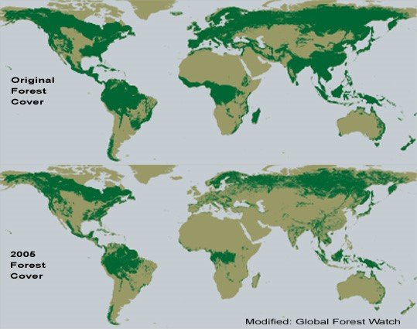
Get started
What’s the problem?
52
Notes:
Show learners the map.
Ask pupils what they notice about forest coverage and how it changes over time.
Identify Scotland and Africa on the map and discuss what changes have happened in forest coverage in these 2 areas.
In Scotland very little native woodlands remain. In the Congo Basin, the forest has been reduced but it still covers a large area.
Tell learners that they are going to find out what happened to Scotland’s forests.
Useful websites include:
www.treesforlife.org.uk/forest
www.forestrycommission.org.uk
www.wwf.org.uk
Reconvene as a class to discuss the findings – and what this kind of deforestation means on a global scale.

Slide 53
Get started
Work in your groups to find out what happened to Scotland’s trees.
What impact has this had/is this having on the three categories below? Again, each group should focus on one each and share their findings with the class:
  People
  Planet
  Wildlife
Useful websites include:
www.treesforlife.org.uk/forest
https://scotland.forestry.gov.uk/supporting
What happened to the trees?
53
Notes:
TEACHER PROMPTS
What has happened to our Scottish forests over the last 300 years?
Why did this happen?
What are the pros and cons of this?
Is something similar happening elsewhere in the world?
What do you think about this?
How might these changes affect different groups of people? What about the planet? What about wildlife?
Do you think these changes might affect things in the long term?
Do you think changes in Scotland's forest had similar effects?
REFLECTION AND EVALUATION
Scotland has lost most of its forests as they have been cut down and used throughout our history. Forests were used for timber, fuel and cleared for farming. Excessive grazing by sheep and deer contributed to this. Both World Wars contributed to further losses of forest. In the Congo Basin forests are being cleared for farming, timber and have also been affected by war

Slide 54
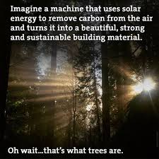
Get started
Work in your groups to find out what is being
done to restore tree cover:
- Internationally
- Here in Scotland
What can we do as individuals to:
- halt the loss of more trees
- restore existing forests
- generate new tree cover?
54
Notes:
· Ask learners to find out:
- What is being done internationally to restore the world’s tree cover.
- What Scotland is doing to restore the world’s tree cover.
- What we as individuals can do to:
halt the loss of more trees
restore existing tree cover
generate new tree cover
· Again, encourage the use of online resources and other materials as sources of information.
· Bring learners together as a class to discuss their findings.

Slide 55
Take it further
Explore more about forests with http://ourforestourfuture.org.uk/
Investigate the local and global issues surrounding climate change and sustainable development through trees and forests with www.forestsforthefuture.co.uk
Go outside and explore a local forest or woodland. Look at how it has been managed past and present, its biodiversity, and how it contributes to our wider well-being. Explore ‘shinrin-yoku’, or ‘forest-bathing’.
Did you know that 95% of our food relies on healthy soils, or that they contain one-quarter of the world’s biodiversity? Find out more with ‘The World Beneath our Feet’.
55

Slide 56
Want more?
Check out these additional resources for this goal:
http://worldslargestlesson.globalgoals.org/global-goals/life-on-land/
http://www.teachglobalambassadors.org/curriculum-areas
https://www.keepscotlandbeautiful.org/sustainable-development-education/eco-schools/ten-topics/biodiversity/
56

Slide 57

Goal 16: Peace, justice and strong institutions
Understanding the SDGs
This goals aims to:
Promote peaceful and inclusive societies for sustainable development, provide access to justice for all and build effective, accountable and inclusive institutions at all levels
57
57

Slide 58

Get started
You each have a voting token.
Cast your votes for the following proposals:
The school day should finish at 15.00 every day.
Free school meals should be available to all.
In S3, we should have the right to opt out of classes we don’t want to do.
How did it feel to be left out of a vote because of something you had no control over?
Can you think of any people who are excluded from voting now – or in the past?
Democracy in action
58
Notes:
Give each learner a counter and invite them to vote on each issue in turn.
Make a count for each vote and then redistribute the counters.
For the second two votes, exclude some of the learners from voting e.g. You can’t vote if you are male / have blue eyes etc. Keep a note of these, as you will refer to them later.

Slide 59
Get started
It’s the year 2050.
Humans have just established the first-ever colony on a new planet.
You have been given the responsibility of designing a new Charter of Rights for the new inhabitants.
In your group, write or draw what this Charter should contain to make sure the new colony is a ‘peaceful and inclusive society’.
Top tips:
Think about:
- The ‘flip’ side: how would you avoid a ‘war-torn and discriminatory’ society?
- What rights should everyone have to make their lives the best they can be?
- Who will make sure that these rights are protected?
A peaceful and inclusive society
59

Slide 60
Take it further
Many of these issues relate to human rights. If you are working towards a RRSA or exploring Children’s Rights in the classroom there are many ways you can explore SDG 16 and make connections with many of the other goals. UNICEF has lots of high quality (and mainly free) resources to help develop this. https://www.unicef.org.uk/rights-respecting-schools/resources/
This UNICEF resource in particular provides an introduction to human rights specifically written for secondary school pupils: https://www.unicef.org.uk/rights-respecting-schools/wp-content/uploads/sites/4/2016/09/Thinking_Rights_Dec12_LR.pdf
Explore equality and diversity past and present in Scotland with the Scotdec ‘A’ Adam’s Bairns?’ resource.
Invite a lawyer to your school to help you explore the differences between Scots Law and the laws of England & Wales, and Northern Ireland. What are the differences? Which parts are the same? What does this mean for people’s everyday lives?
60

Slide 61
Want more?
Check out these additional resources for this goal:
http://worldslargestlesson.globalgoals.org/global-goals/peace-and-justice/
http://www.teachglobalambassadors.org/curriculum-areas
61

Slide 62

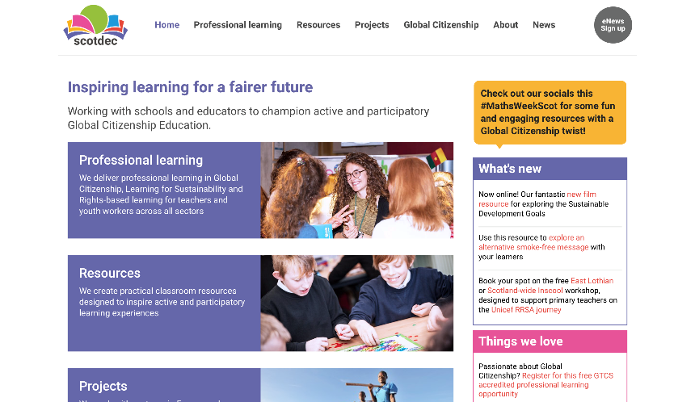
Further information
visit scotdec.org.uk
Check out our website and social media channels for all the latest information, opportunities, events, professional learning and resources with a Global Citizenship theme!
62

Slide 63

resources | projects | professional learning
End of presentation
scotdec.org.uk
@scotdeclearning
/scotdeclearning

